Slide 1
Language Models
Fundamentals of Artificial Intelligence

Slide 2
Natural Language Processing (NLP)
field within AI and linguistics
aim: enable machines to understand and generate human language
language models: subfield of NLP
aim: model and understand language patterns (typically by learning to predict the next word in a sentence)
capabilities of large language models (LLM) cover most of NLP

Slide 3
NLP Tasks
part-of-speech tagging
named entity recognition
text classification
machine translation
summarization
question answering
text generation (chatbots)
code generation
…

Slide 4
Symbolic vs Neural NLP
symbolic NLP = rules and logic
uses hand-crafted rules, lexicons, and grammars
relies on linguistic knowledge and logic-based systems
neural NLP = data and learning
uses machine learning (especially deep learning)
learns patterns from large datasets without explicit rules

Slide 5
Large Language Models (LLM)
recent hype around LLMs
fully started with ChatGPT release end of 2022
technical backbone: transformer architecture
transformers also applicable to computer vision (alternative to convolutional neural networks)

Slide 6
Tokenization
tokenization: breaking text in chunks
word tokens: different forms, spellings, etc → undefined and vast vocabulary
character tokens: not enough semantic content (longer sequences)
popular compromise: byte-pair encoding

Slide 7




Embedding Layers
representation of entities by vectors
→ semantic similarity
most famous application: word embeddings
→ associations (natural language processing)
but general concept: embeddings of (categorical) features (e.g., products in recommendation engines)
learned via co-occurrence (e.g., word2vec)
but also direction of difference vectors interesting (analogies):
source

Slide 8
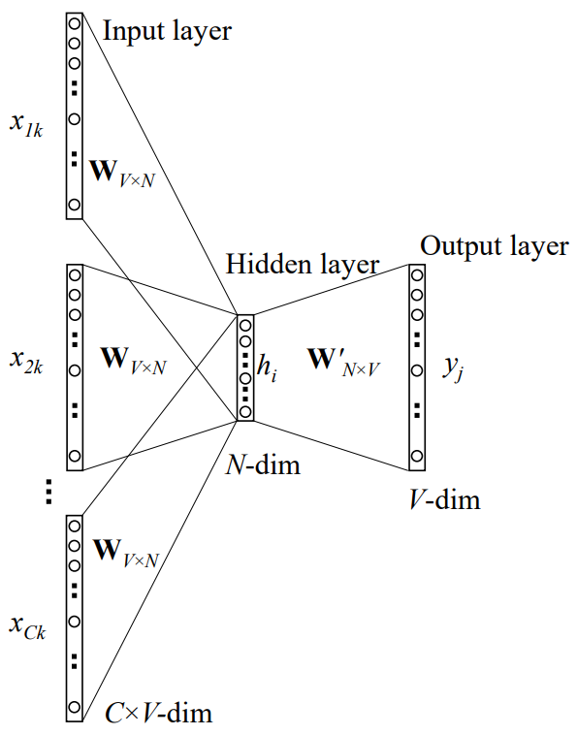
Some Thoughts on Word Embeddings
can be implemented as
neural network with single hidden layer (linear activation)
using, e.g., bag-of-words approach (predict masked word from its surroundings)
not context-aware
CBOW:
source
softmax of target word
word vector (embedding) by multiplication with one-hot vector
one-hot vectors of context words

Slide 9



Word Embeddings as Part of Language Model
language models contain embedding matrix as part of learned parameters
typically several hundred dimensions for word vectors (to be compared with vocabulary sizes of many thousands)
(can also be extracted and subsequently used as pretrained embeddings for other task)
next-word prediction:
source

Slide 10
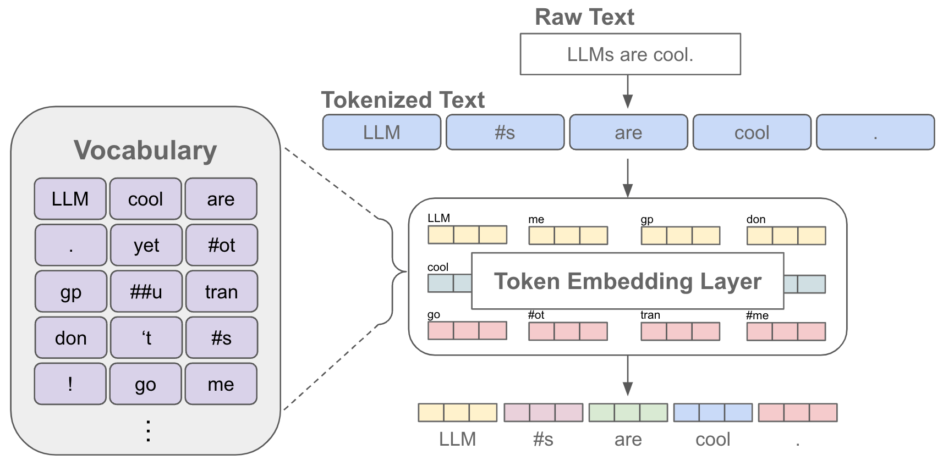
Tokenization & Embeddings
source

Slide 11
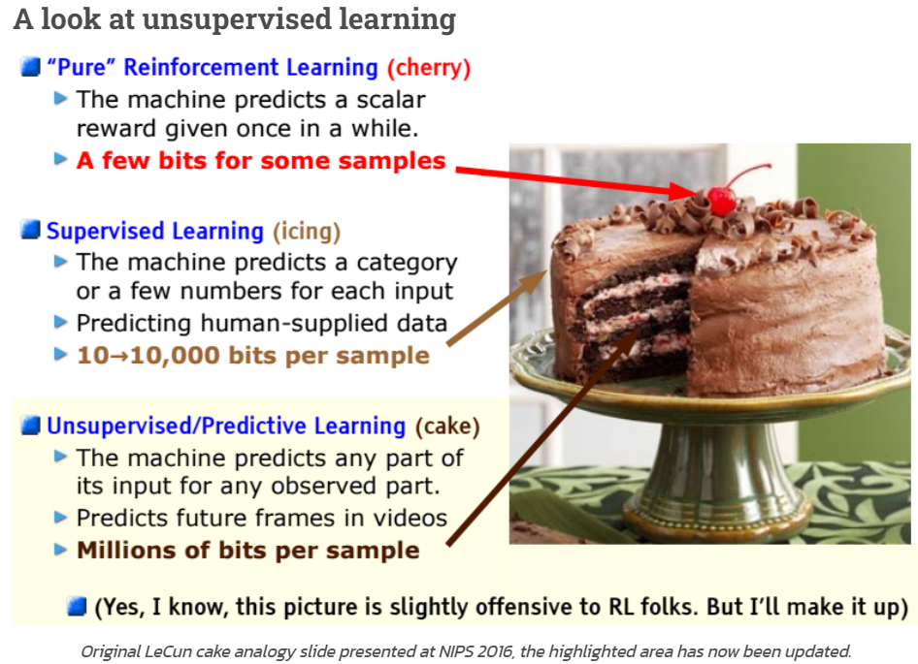
Self-Supervised Learning
ML needs lots of training data
unsupervised learning (learning by observation)
no target information → kind of “vague” pattern recognition (but plenty of data)
can be cast as self-supervised learning:
input-output mapping like supervised learning
but generating labels itself from inputs
source
The Lord of the Rings is considered one of the greatest fantasy
The Lord of the Rings is considered one of the greatest fantasy books
$$⋮$$
now run this across the entire internet …

Slide 12

Context Awareness: Transformer
original transformer: sequence-to-sequence model (e.g., for machine translation)
Attention Is All You Need:
completely replaced recurrent neural networks (RNN)
much more parallelization → bigger models
better long-range dependencies thanks to shorter path lengths in network (less sequential operations)
encoder/decoder stacks (depth): output fed as input to next one
encoder
decoder

Slide 13
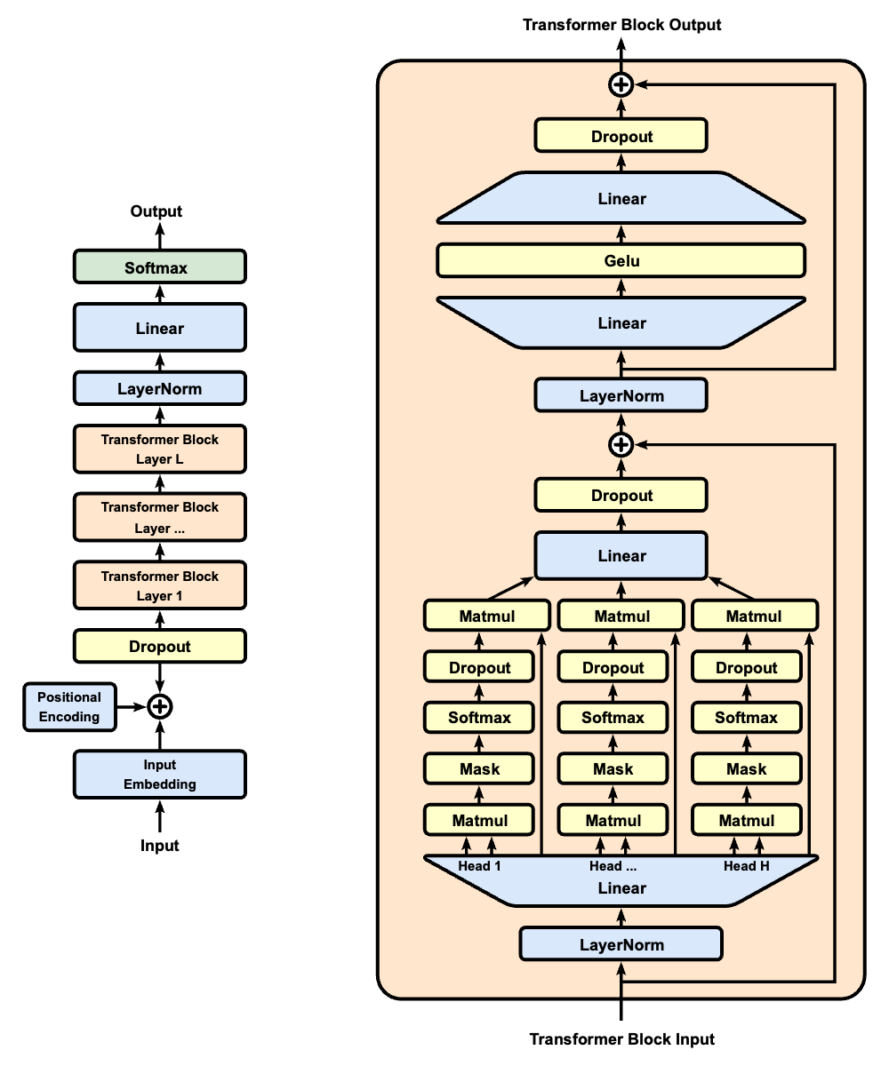

Self-Attention Mechanism
GPT (decoder-only):
evaluating other input tokens in terms of relevance for encoding of given token
computational complexity quadratic in length of input (each token attends to each other token)
only allow to attend to earlier positions in sequence (masking future positions)
source

Slide 14


Scaled Dot-Product Attention
softmax not scale invariant (largest component dominates for large scale) and dot product larger for more vector dimensions
3 matrices created from input embeddings by multiplication with 3 different weight matrices
query $Q$
key $K$
value $V$
filtering: multiplication of attention probabilities with corresponding key-word values
scoring each of the key words (context) with respect to current query word: correlation between inputs (not independent as in conventional neural networks)
key-value pairs
query
source

Slide 15
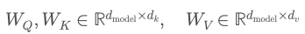
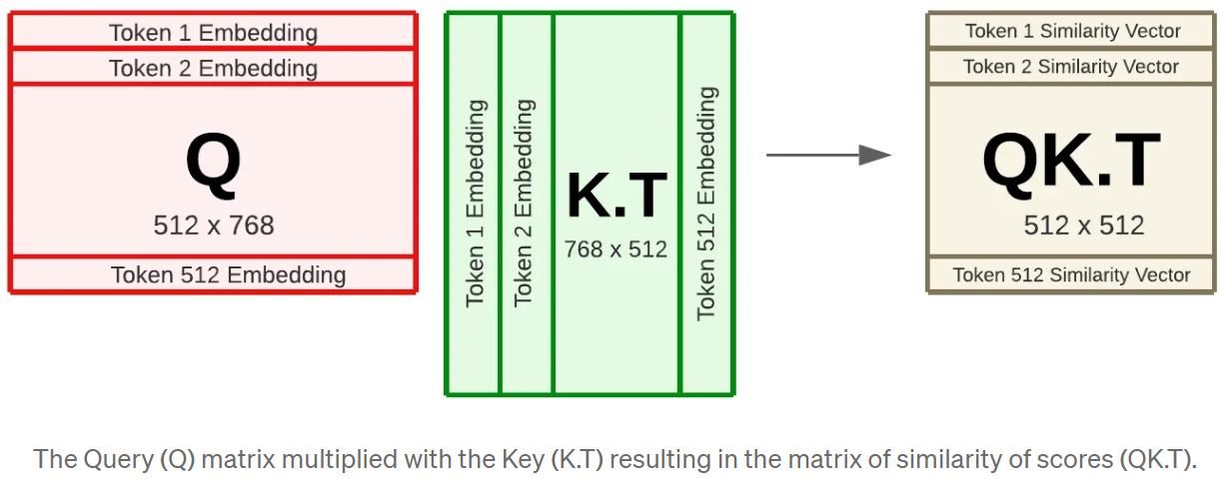
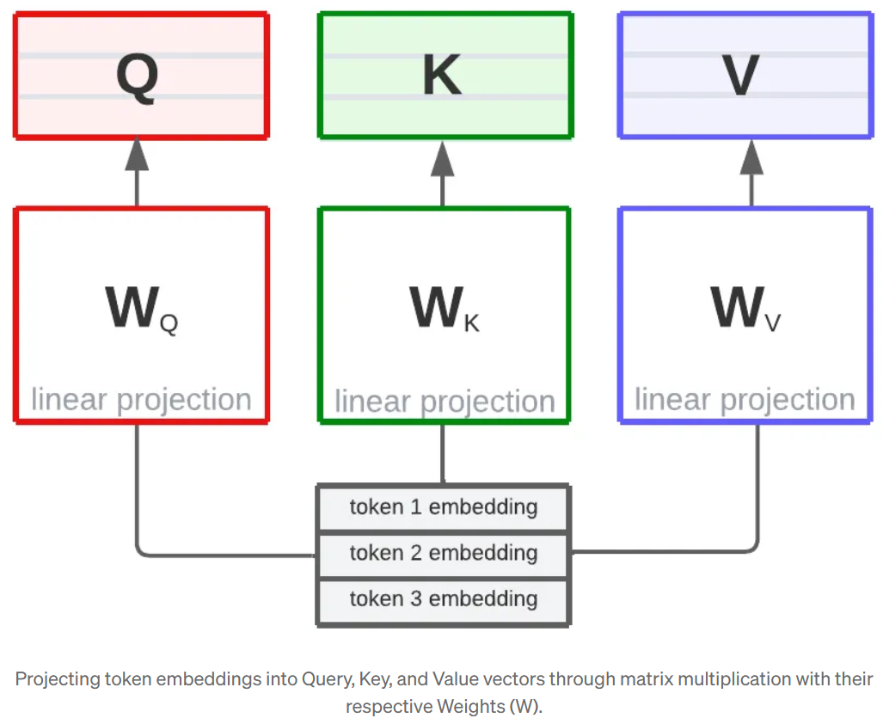
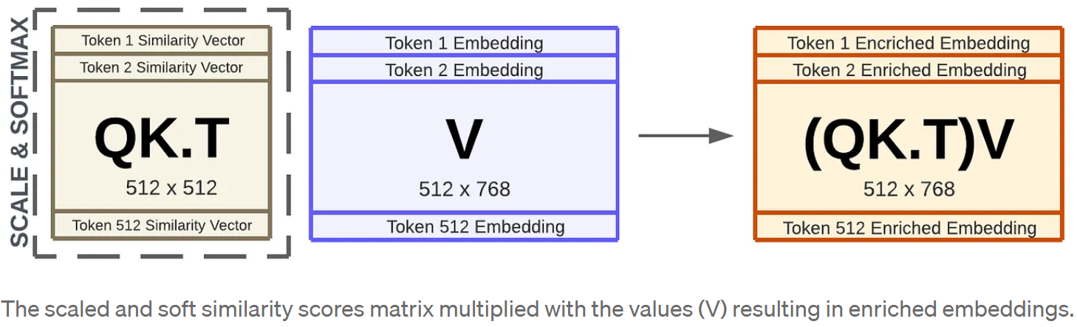
Example: Dimensions in BERT
often $d_{k}=d_{v}=d_{model}$ (but not necessarily)
2
linear projections
1
sequence length $n$
upper bound: context length of model
(design choice)
learned parameters
inputs
3
source

Slide 16
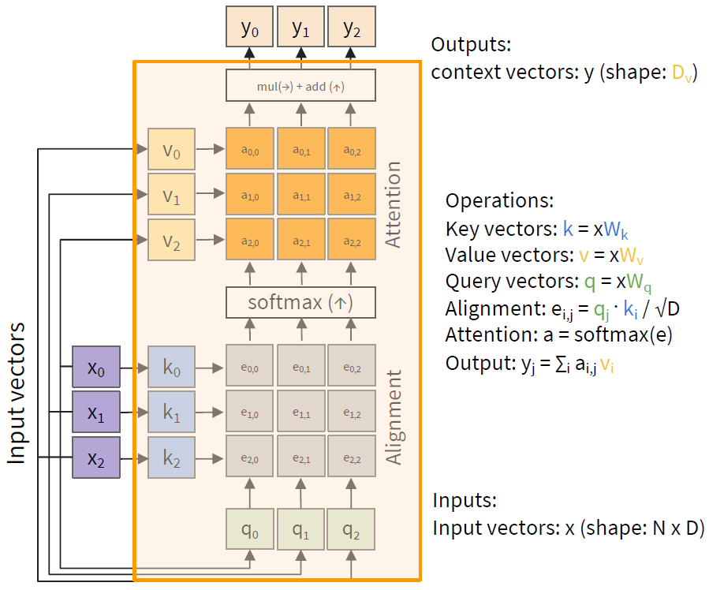
MatMul
$$d_{v}$$
$$d_{k}$$
$d_{model}$: embedding size
weighted average: reflecting to what degree a token is paying attention to the other tokens in the sequence

Slide 17
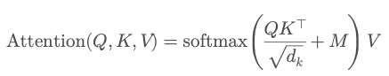
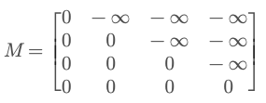
Attention Mask
attention mask
causal masking:
dynamically mask future positions in sequence by setting to $−∞$

Slide 18
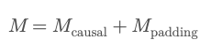
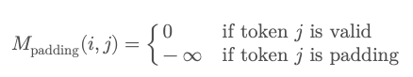
Padding Mask
goal: (technically) batch together sequences of different lengths
→ include fake tokens to pad shorter ones to the max length in the batch
then add a padding mask to let the model ignore these fake tokens:

Slide 19


Multi-Head Attention
often $d_{k}=d_{v}={d_{model}}/h$
and all $h$ heads share the same $d_{k}$ and $d_{v}$
multiple heads: several attention layers running in parallel
different heads can pay attention to different aspects of input (multiple representation sub-spaces)
source
source

Slide 20
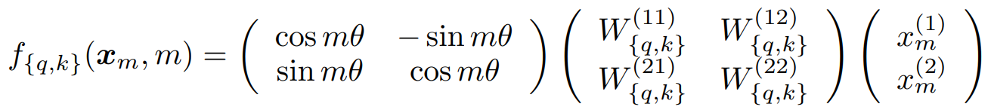
Positional Encoding
defines context length
attention permutation invariant → need for positional encoding to learn from order of sequence
different options:
for each absolute position (from 1 to maximum sequence length), add a learned vector (of dimension $d_{model}$) to input embeddings → each positional embedding independent of others
add fixed sinusoidal functions for each position and dimension $i$
rotate input embeddings by multiples (position) of a small angle (RoPE) → captures both relative and absolute positions
$${PE}_{pos,2i}=\sin\left(\frac{pos}{{10000}^{\frac{2i}{d_{model}}}}\right) {PE}_{pos,2i+1}=\cos\left(\frac{pos}{{10000}^{\frac{2i}{d_{model}}}}\right)$$

Slide 21
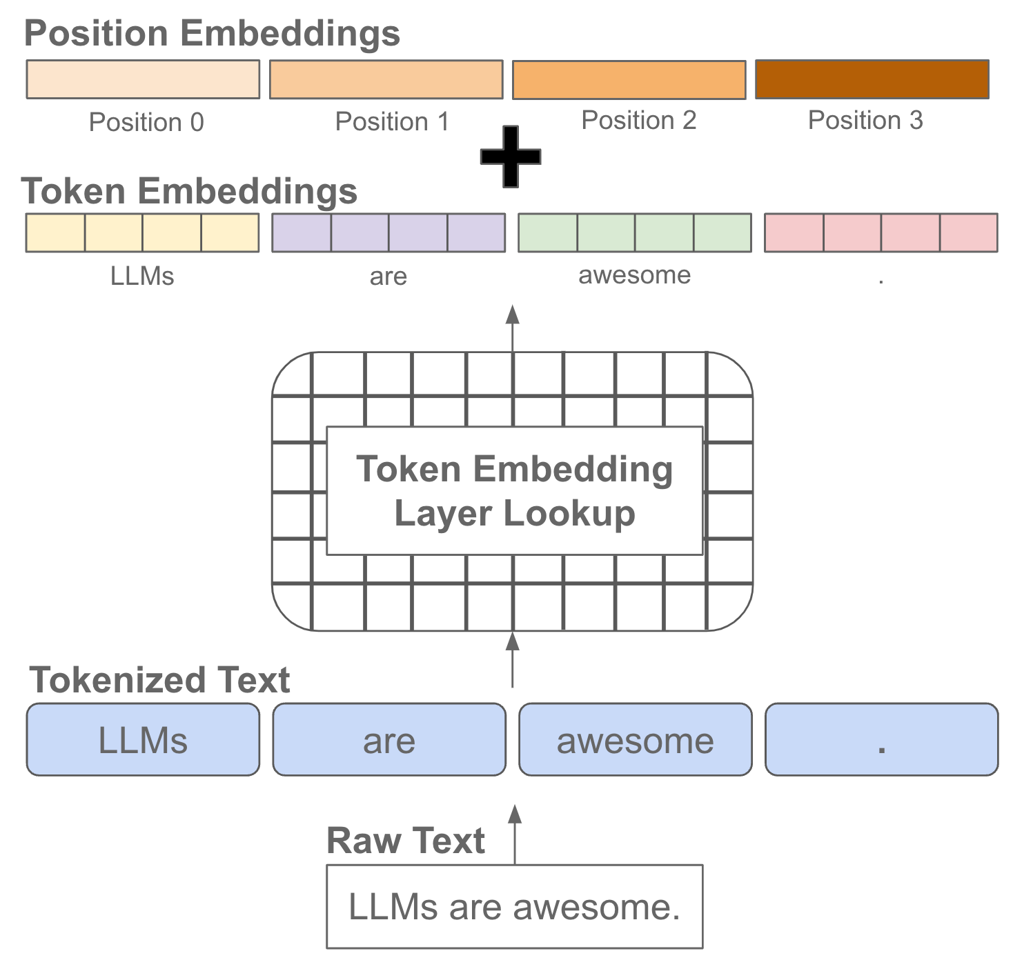
source

Slide 22

Skip Connections and Layer Normalization
skip connections improve robustness by
preserving original input (attention layers as filters) as well as gradients (mitigate vanishing-gradient problem)
easier learning of identity functions (useful for disregarding modules that do not improve model performance)
layer normalization improves stability, convergence, and generalization by normalizing activations per input token
source

Slide 23
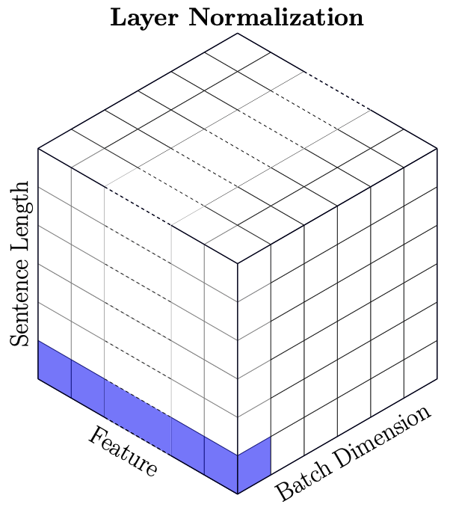
Batch vs Layer Norm
batch norm typically in computer vision
layer norm in NLP (variable-sized inputs)

Slide 24
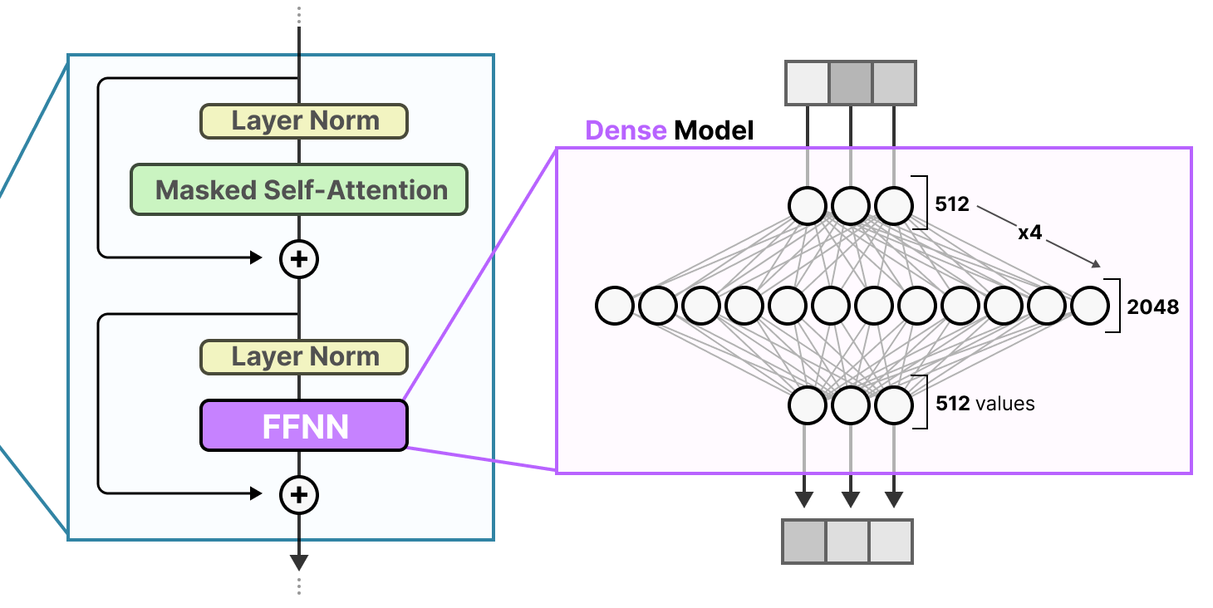
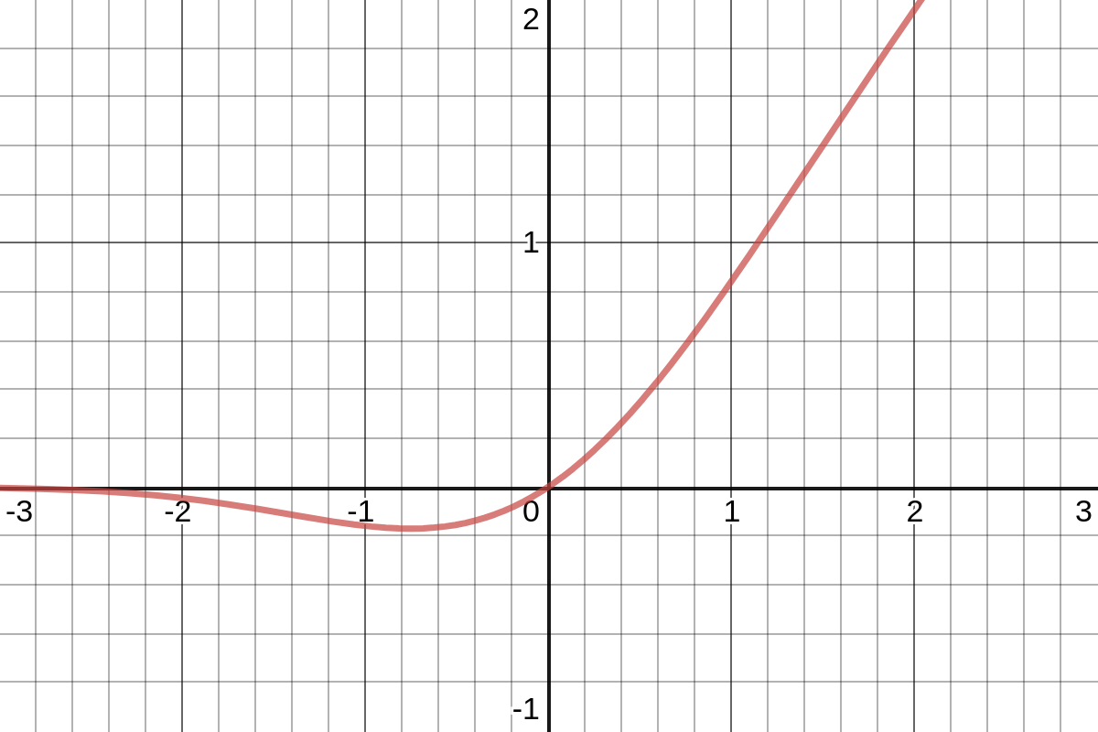
Role of Feed-Forward Neural Networks (FFNN)
position-wise FFNNs:
following each attention layer, apply an identical FFNN (with two layers) independently to each embedding vector
(correspond to bulk of overall parameters)
source
can be interpreted as compute after connect (attention)
attention is just weighted averaging
→ need for non-linearities (often GeLU activations) to capture more complex patterns

Slide 25
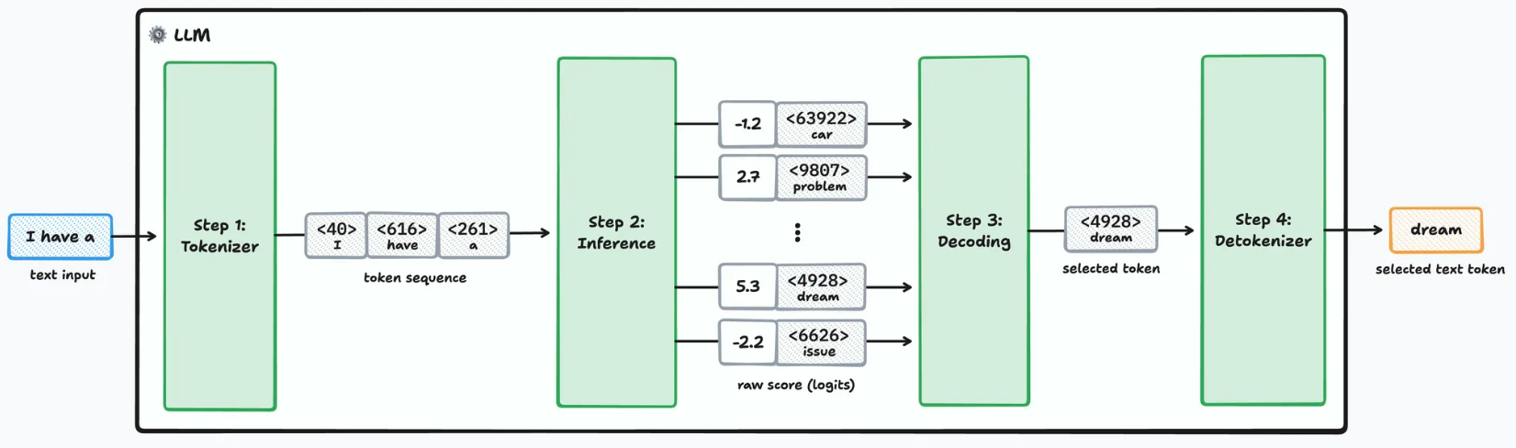
Next-Token Prediction
forward pass:
source

Slide 26
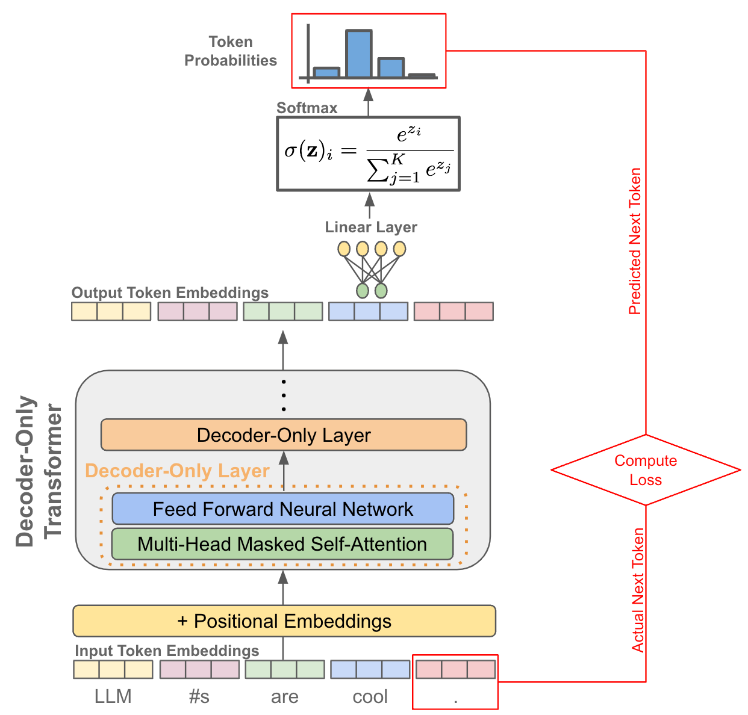

From Embeddings to Probabilities
next-token probabilities for each token in vocabulary
transformation to probabilities
de-embedding to vocabulary: projection to vector of logits
for projection, only use contextual embedding of last token (still need all contextual embeddings due to matrix multiplication in self-attention)
n: sequence length
N: vocabulary size
d_model: embedding size
(masked token for encoder-only transformers)
source
source

Slide 27
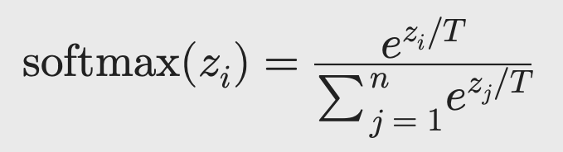
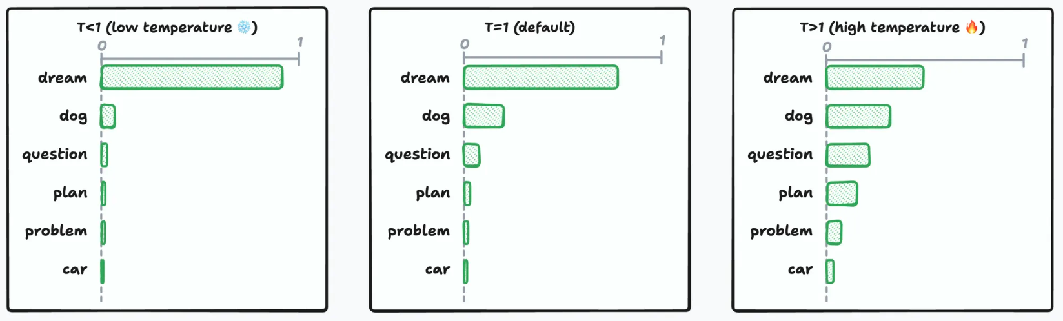
Token Selection at Inference
typically, pick according to probabilities
degree of randomness can be controlled by temperature parameter $T$
source
$T→0$ → greedy
creativity ;)

Slide 28
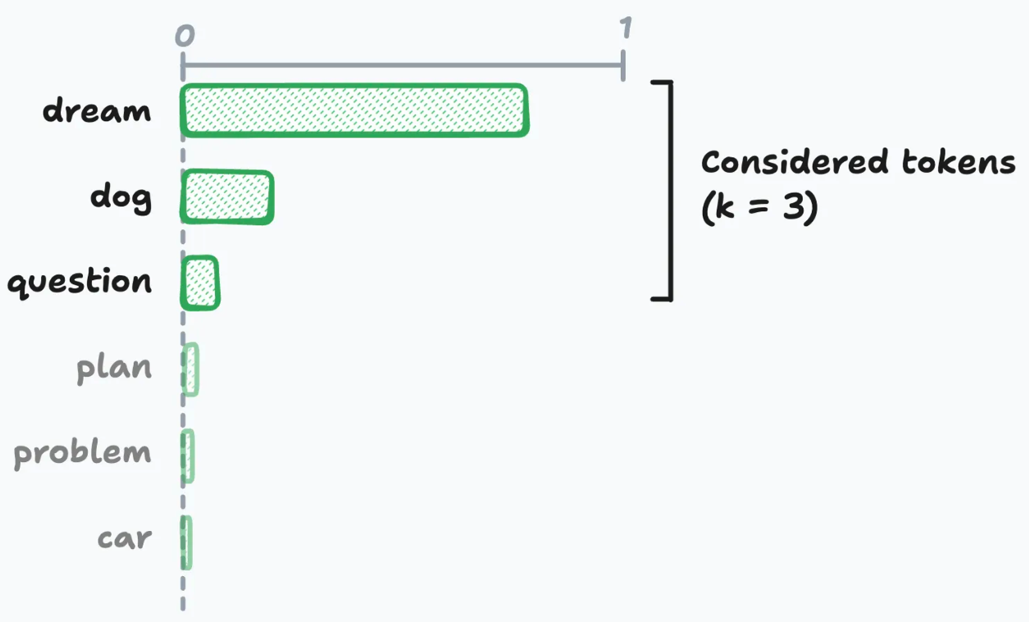
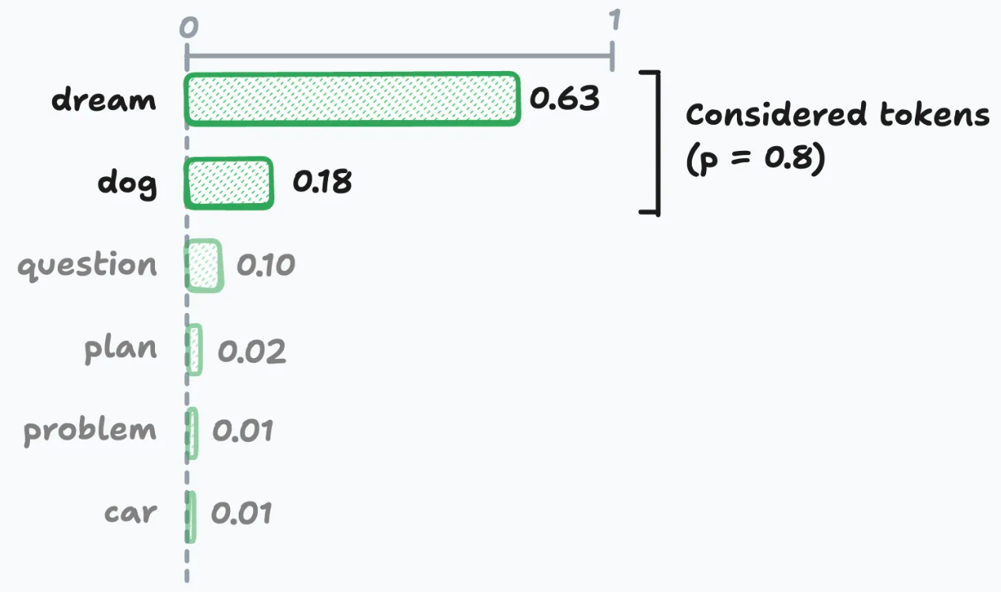
top-k & top-p Sampling
source

Slide 29
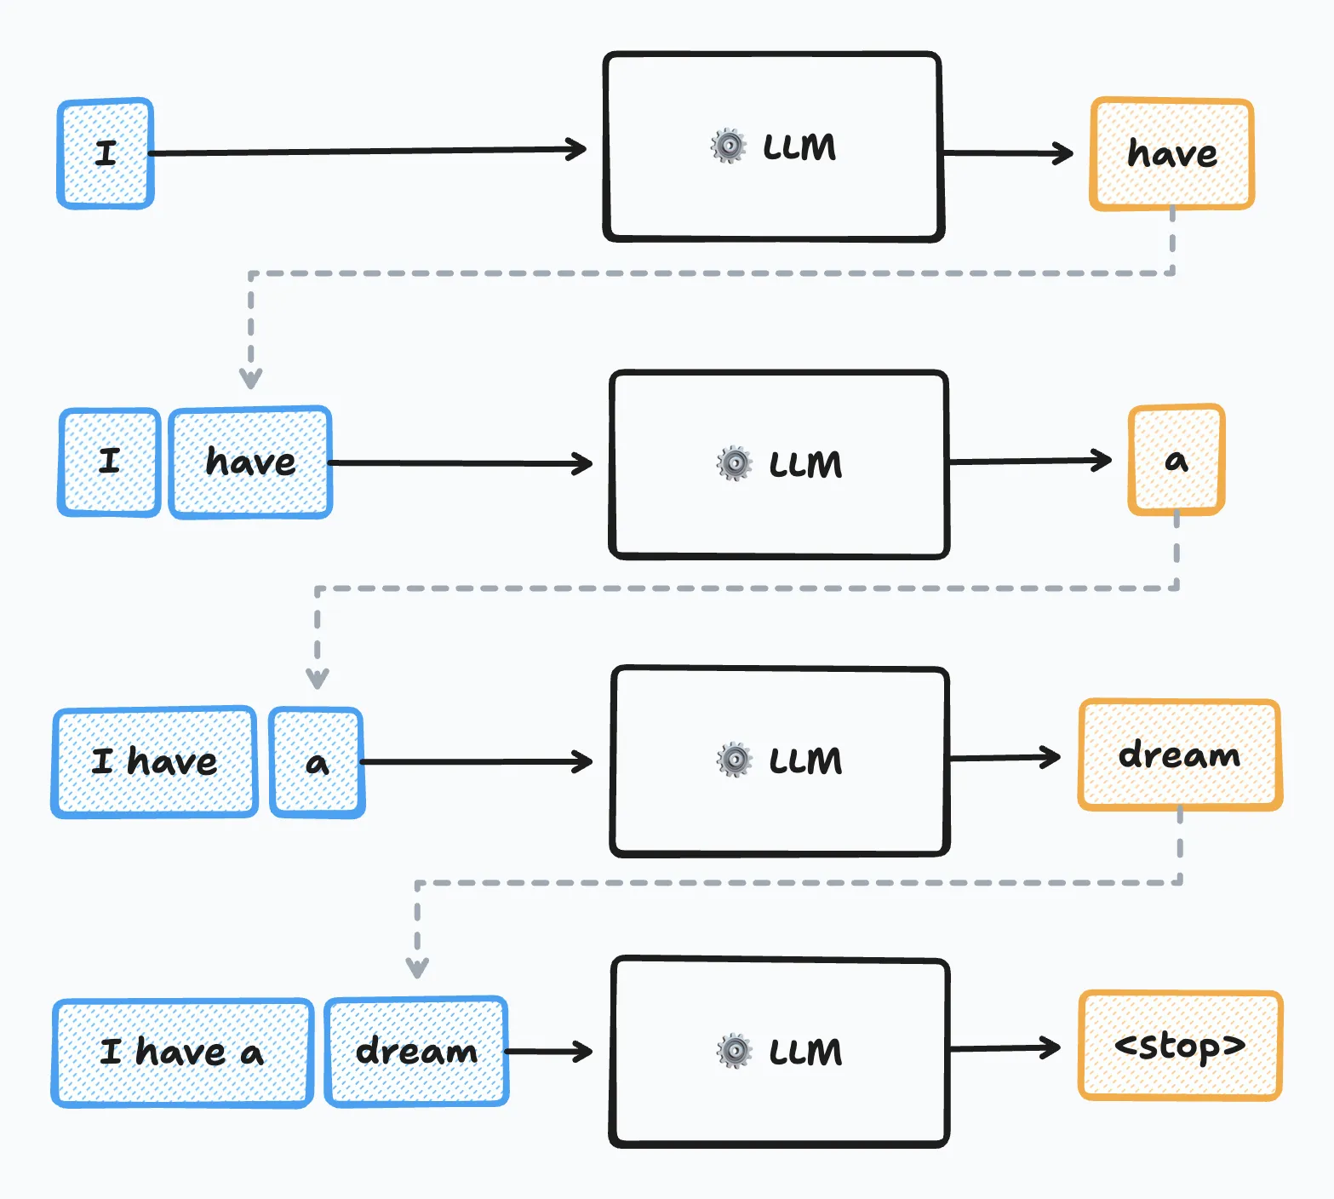
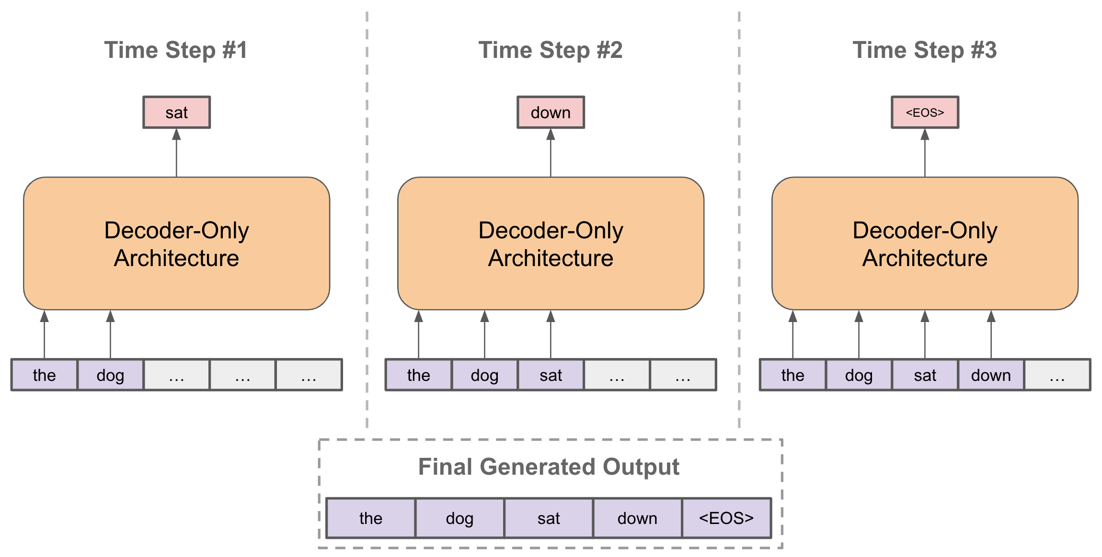
Sequence Completion
autoregressive:
at each step, choose one output token, then add it to decoder input sequence for next step
prompt:
externally given initial sequence for running start and context on which to build rest of sequence
source
source

Slide 30
Training Loss
cross-entropy loss: $L\left(y,\hat{y}\right)=−\sum_{k=1}^{K}{y_{k}\log{{\hat{y}}_{k}}}$
$k$: each token in vocabulary
$y_{k}$: next-token targets
→ $1$ or $0$
${\hat{y}}_{k}$: next-token probabilities
during training, a next-token-prediction loss is calculated for every position in input sequence (not just the last one)
→ earlier positions have shorter effective contexts (masking of future positions)
reason: mirroring actual inference case of autoregressive text generation and arbitrary prompts
total loss = sum of individual losses

Slide 31

Transformer Types
encoder-only transformers:
goal: language understanding
training: masked-token prediction
decoder-only transformers:
goal: text generation
training: next-token prediction
aka causal
prime example: BERT
prime example: GPT
source
encoder-decoder transformers:
goal: sequence-to-sequence models
training: next-token prediction

Slide 32
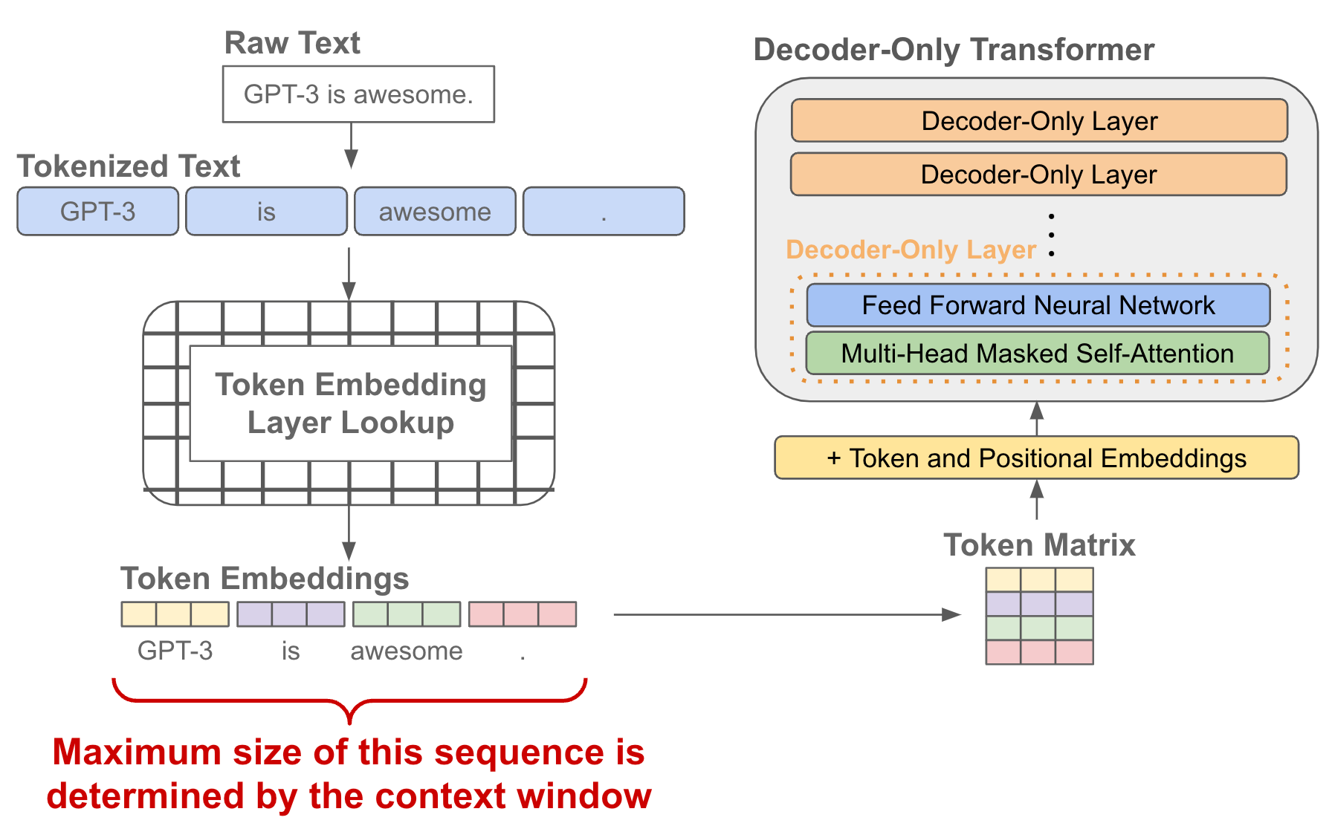
Decoder-Only = Autoregressive Models
next word
today typically synonymous with LLM
stack of transformer decoders
→autoregressively generated sequence of tokens (directly usable as backbone of a chatbot)
training objective: next-token prediction from context
source

Slide 33
Encoder-Only = Bidirectional Models
training objective: masked tokens to be predicted from context
→ aka masked language models (MLM)
bidirectional: jointly conditioning on both left and right context
stack of transformer encoders
→ contextual embeddings (for later use in specific language-understanding tasks like text classification, sentiment analysis, named entity recognition)
still needs a decoder head for training purposes, using the hidden state of the masked token (dedicated [MASK] token) for projection to vector of logits
finetuning

Slide 34
Autoregressive Text Generation
LLMs (autoregressive transformers) generate one output token at a time (according to predicted probabilities)
then add it to the context for the prediction of the next token
→ resulting in a full text, sampled from predicted probabilities

Slide 35
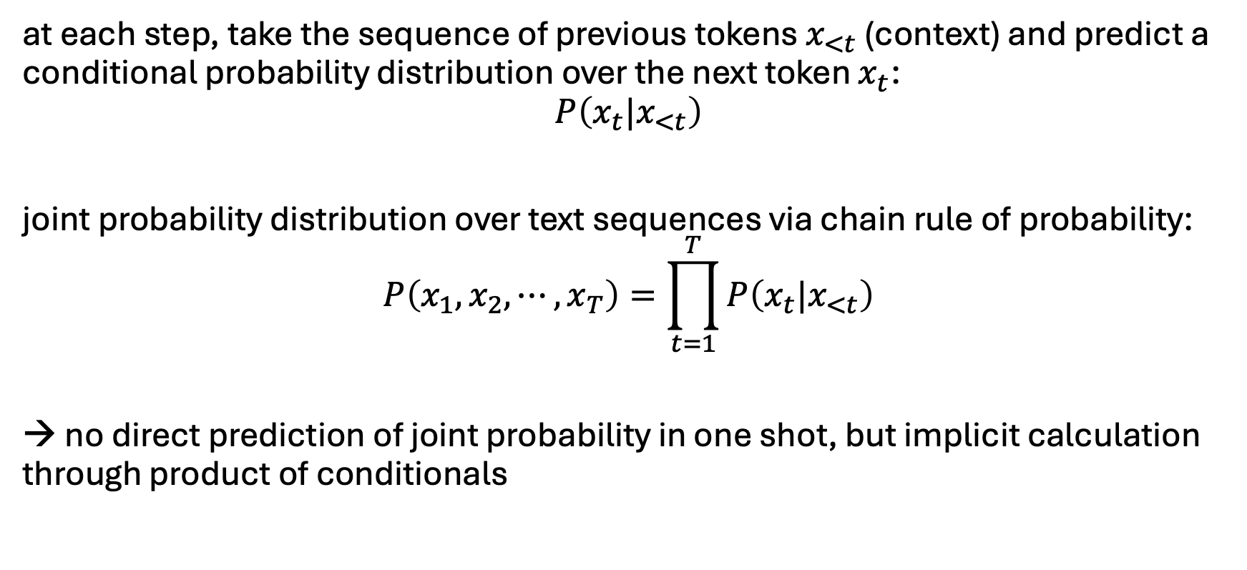
How are LLMs Generative Models then?
at each step, take the sequence of previous tokens $x_{<t}$ (context) and predict a conditional probability distribution over the next token $x_{t}$:
$$P\left(x_{t}{|x}_{<t}\right)$$
joint probability distribution over text sequences via chain rule of probability:
$$P\left(x_{1}, x_{2}, ⋯, x_{T}\right)=\prod_{t=1}^{T}{P\left(x_{t}{|x}_{<t}\right)}$$
→ no direct prediction of joint probability in one shot, but implicit calculation through product of conditionals

Slide 36
Prompting
feed information into decoder-only transformer via input prompt
→ attention to context
using all the knowledge acquired during internet-scale pretraining and stored in weights
kind of programmable neural network
→ a new paradigm: one model for many tasks

Slide 37
In-Context Learning (ICL)
the model’s ability to condition its outputs on patterns, instructions, or demonstrations present in the context window, without updating parameters (in contrast to fine-tuning)
→ not really learning (rather inference-time pattern recognition: locating and using relevant learnings from training)
ICL is the emergent phenomenon that makes prompting powerful.

Slide 38
LLMs
autoregressive text generation of decoder-only transformers allows prompting of models (can output text to arbitrary topics)
→ enables chatbots like ChatGPT
triggered hype about generative AI and started an LLM scaling race (the larger the model, the better the capabilities)
lightweight PyTorch re-implementation of GPT: minGPT
more powerful: nanoGPT, LitGPT

Slide 39
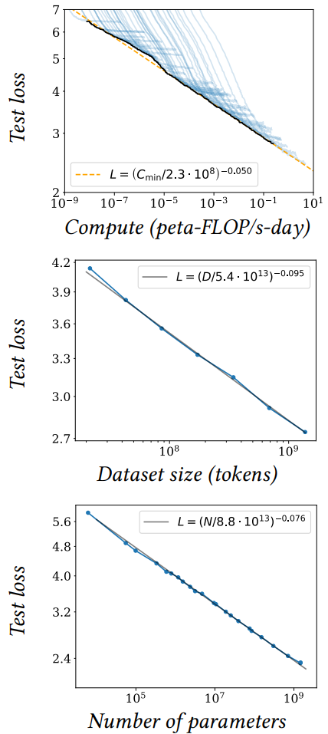
Size Matters: LARGE Language Models
scaling laws, Chinchilla: coupled performance power laws with model size, amount of training data, and compute
→ era of large-scale models
emergent abilities of LLMs:
multi-task learning: perform new tasks at test time without task-specific training (via prompting)
reasoning capabilities
source

Slide 40
Some LLM Numbers
as usual, comes in base and instruct variants
example Kimi K2 (Mixture-of-Experts model):
vocabulary size (tokens): 160K
embedding dimension: 7,168
context length (tokens): 128K
total parameters: 1T
training tokens: 15.5T
number of layers: 61
number of attention heads: 64
number of experts: 384
→ a lot of memorizing
compression of the internet

Slide 41
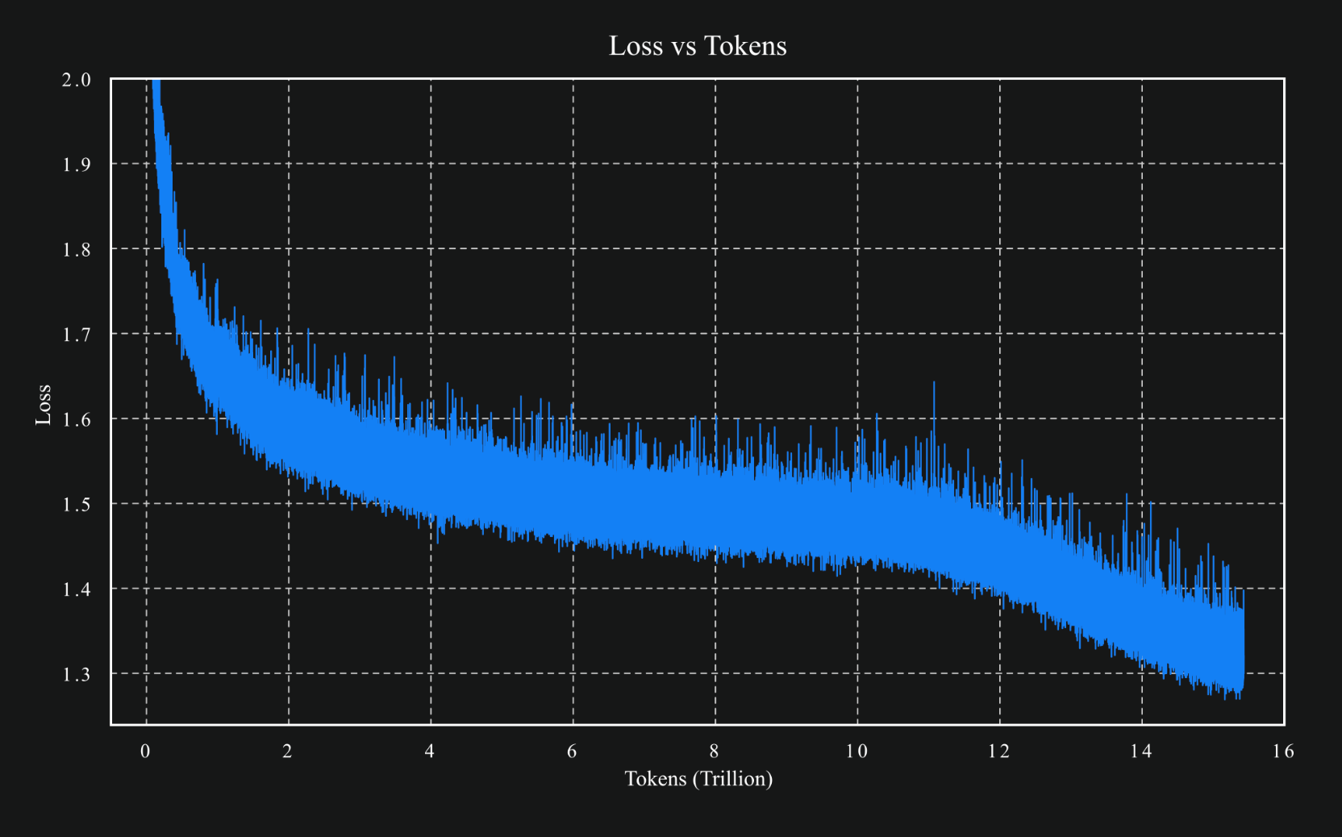
source

Slide 42
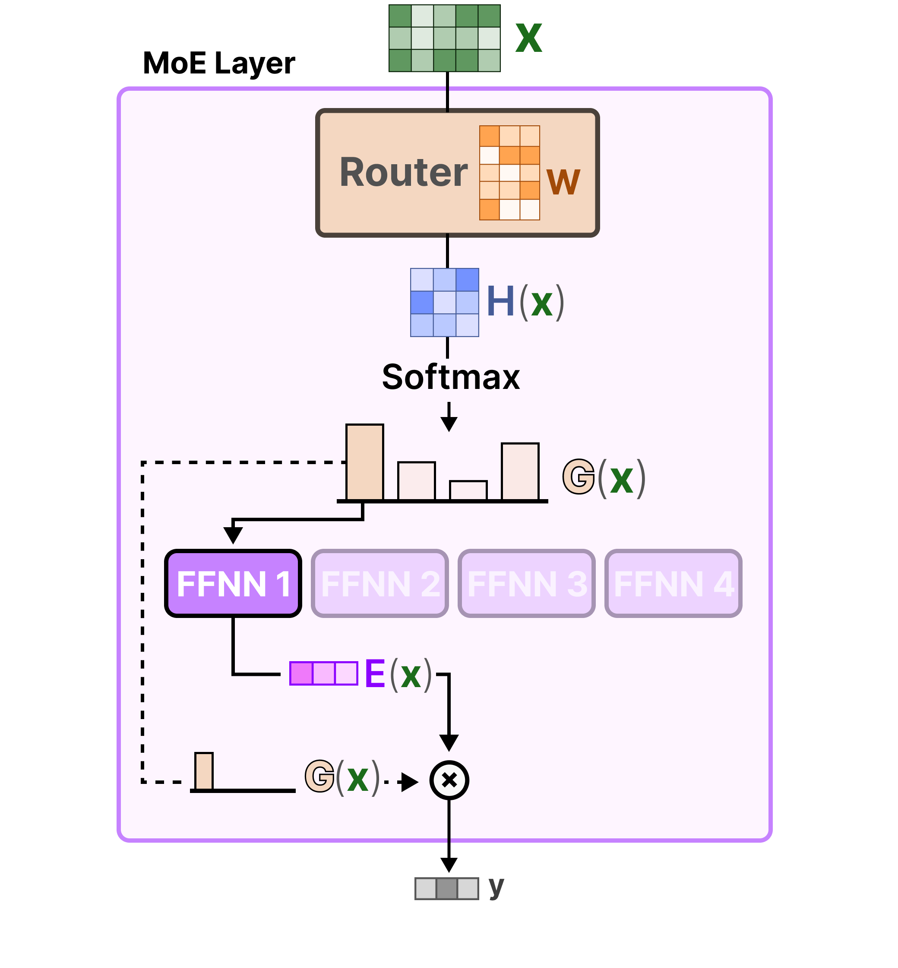
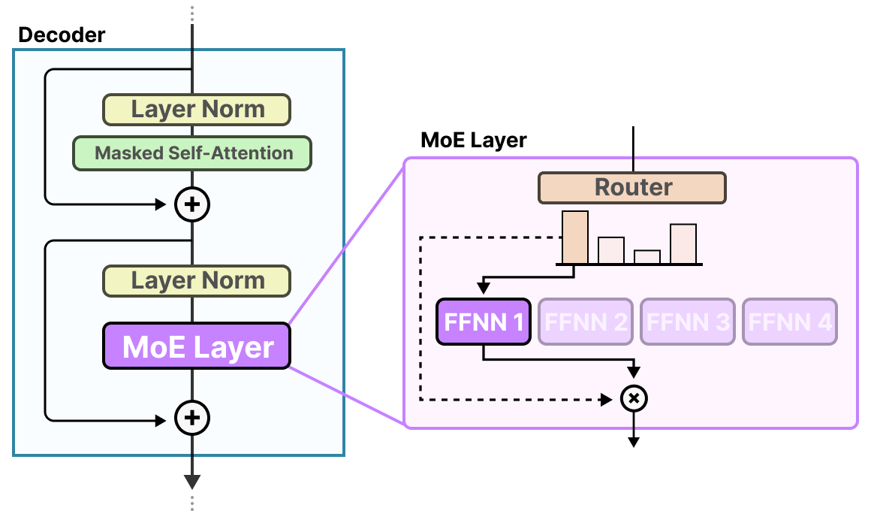
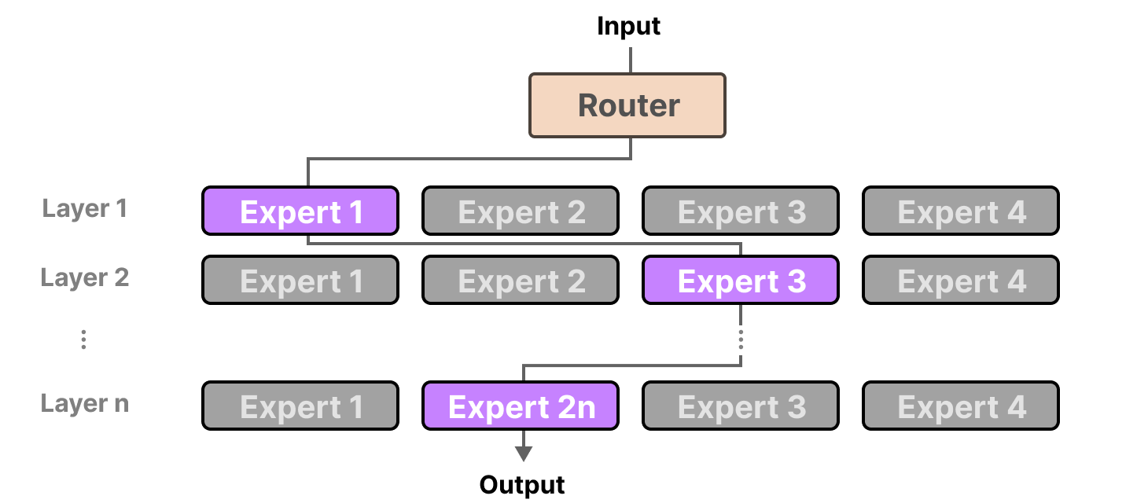
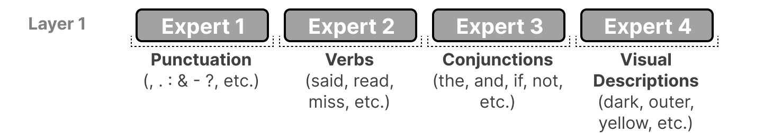
Mixture-of-Experts (MoE)
FFNN itself
idea: replace big FFNN with several smaller ones and activate only few
→ less active parameters
different paths for each token:
example (actually more abstract):

Slide 43


dialogue & alignment breakthroughs
foundational era
dialogue model (powered Bard)
reasoning + chain-of-thought prompting
the architecture everything is built on
pioneered instruction-style tasks
Transformer
Google
BERT 340M
Google
T5
Google
LaMDA
Google
PaLM 540B
Google
used for Google search
2017
2018
2019
2020
2021
2022
2023
GPT-1 117M
OpenAI
GPT-2 1.5B
OpenAI
GPT-3 175B
OpenAI
InstructGPT
OpenAI
ChatGPT
OpenAI
showed coherent long-form text generation
proved general-purpose language generation
introduced RLHF to align models with human intent (basis for ChatGPT)
mass adoption

Slide 44
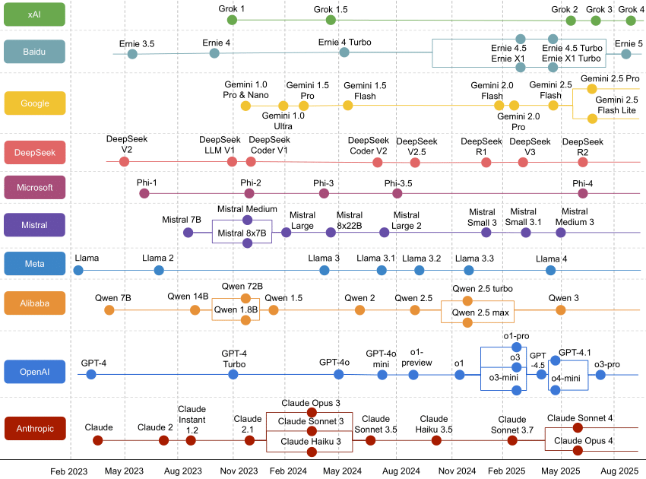



generative chatbots
evolved from LaMDA & PaLM
integrated Google ecosystem
MAI-1
open-source models
GPT-5
gpt-oss
ChatGPT
different alignment strategy
tailored for business users

Slide 45
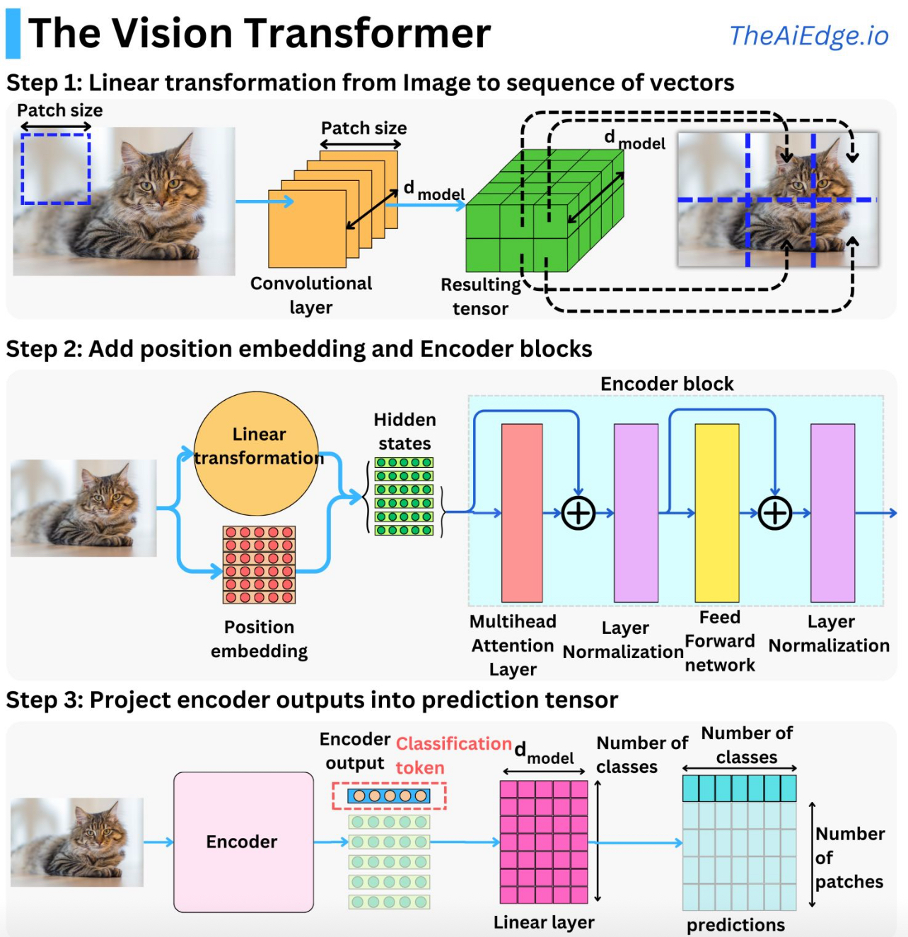

Image Classification with Vision Transformer
source
formulation as sequential problem:
split image into patches (tokens) and flatten, add positional embeddings
processing by transformer encoder:
pretrain with image labels, fine-tune on specific data set

Slide 46

Combination of Vision and Text
example: CLIP (Contrastive Language-Image Pre-training)
learn image representations by predicting which caption goes with which image (pretraining)
→ zero-shot transfer (e.g., for image classification)
transformer
ViT
(or ResNet)
cosine similarity
joint embedding

Slide 47
Modern Language Models in a Nutshell
tokenization: split text into chunks
pretraining: self-supervised, next- or masked-token prediction
vector embeddings from tokens (semantic meaning)
add positional encoding (attention permutation-invariant)
attention mechanism (transformer) → contextual embeddings
finetuning: specialization
classification model (specific task):
finetuning on labeled data set (often using encoder-only transformer)
assistant/chatbot (multipurpose):
instruction tuning (decoder-only transformer), potentially followed by alignment

Slide 48
Transfer Learning from Foundation Models
idea:
pretrain a big model (called foundation model) on a broad data set
then use these learnings for subsequent trainings on specific (typically narrow) data by means of finetuning or feature extraction
→ here: self-supervised, internet-scale pretraining of models like BERT or GPT
works well for homogenous, unstructured data (e.g., text, images)
but very difficult for heterogenous, structured/tabular data

Slide 49
Finetuning of BERT
get pretrained BERT as foundation model (MLM pretraining: loss computed against projection from last hidden state of [MASK] token to vector of logits)
remove pretraining classification head (→ get contextual token embeddings)
add another, task-specific classification head (see a few examples on the following slides)
train (finetune) with data for actual task at hand (starting with random weights for new classification head and pretrained weights for the rest)
options: finetune all pretrained weights or only a part (freezing the others)

Slide 50
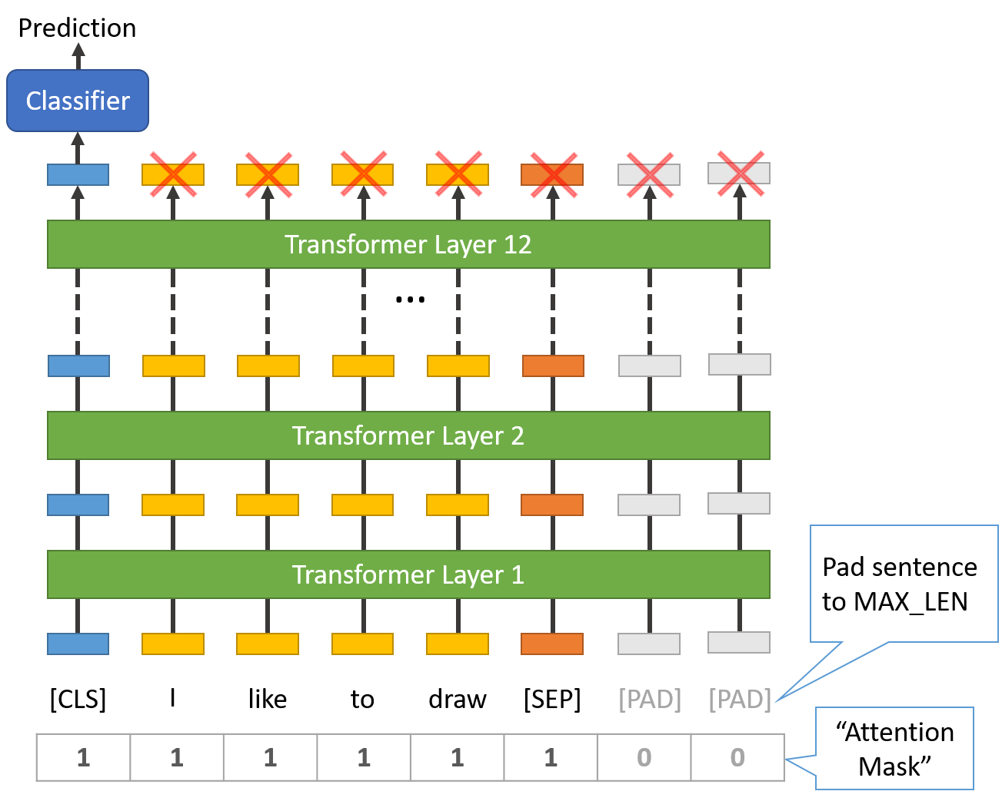
Example: Sequence Classification
e.g., classify sentiment or topic
a special [CLS] token is prepended to the input (already present in pretraining)
its final hidden state (vector embedding) is passed into a classification head (resulting in logits over different categories)
→ [CLS] embedding is finetuned to summarize the whole sequence
(alternative without [CLS]: average pooling )
source
sequence classification via [CLS] token

Slide 51
Example: Sentence Embeddings
use case: sentence similarity / retrieval (see RAG)
BERT optimized for NSP, not for mapping independent sentences into a comparable vector space → need to finetune on considered similarity label
paraphrase (yes or no)
natural language inference (entailment/contradiction/neutral)
semantic textual similarity (human-judged similarity score) → regression loss
approach with vanilla BERT:
input: [CLS] Sentence A [SEP] Sentence B [SEP]
[CLS] token embedding as aggregate representation of the pair
classifier/regressor head trained directly on considered similarity label

Slide 52
SBERT
issue with vanilla BERT:
prediction of similarity score requires each pair of sentences to be processed together (no independent sentence embeddings) → $O\left(n^{2}\right)$ for $n$ sentences
SBERT: instead of finetuning vanilla BERT,
uses two (or three) copies of same BERT model (with shared weights)
passes each sentence through one of the copies to produce its embedding from last hidden states (use [CLS] token or average pooling)
puts common head on top of copies, optimizing $similarity\left(u,v\right)≈label\left(u,v\right)$ of sentence embeddings $u$ and $v$ (→ different SBERT versions for different similarity tasks/labels)
→ cosine similarity (or dot product) can then be used to compare independent sentence embeddings

Slide 53
Example: Token Classification
examples of use cases:
part-of-speech tagging: assigning each word in a sentence its grammatical role (or part of speech) such as noun, verb, etc.
named entity recognition: identifying and classifying named entities (proper nouns) in text into predefined categories like Person, Organization, Location, Date, etc.
per-token predictions needed → no pooling or [CLS] usage
instead, just project each token’s hidden state independently into logits and sum the per-token losses in each sequence

Slide 54
Finetuning Scenarios
features more generic in early layers (e.g., token structure, syntax, part-of-speech) and more specific to the pretraining data in later layers (e.g., word sense, entity linking)
for small finetuning data sets, typically keep weights of early layers fixed to avoid overfitting
for large finetuning data sets (less danger of overfitting), finetuning all layers can be beneficial

Slide 55

Instruction Tuning
instruction tuning is a form of supervised finetuning (SFT)
so is the finetuning discussed before (although usually just called finetuning)
source

Slide 56
Instruction Tuning Data
instruction tuning = SFT with instruction–response data
Instruction: "Summarize this article in one sentence."
Output: "The article discusses the effects of climate change on polar bears."
instruction tuning data fed to model as input sequences, just like in pretraining
objective still next-token prediction (language modeling)
structure of text sequences only thing telling the model where instruction ends and response begins
also learns formatting: desired patterns embedded in instruction–response pairs

Slide 57
Base vs Instruction-tuned LLM
Explain why the sky is blue, as if you were talking to a curious 10-year-old.
base LLM response:
instruction-tuned LLM response:
“The sky is blue because of the way light interacts with the atmosphere. Sunlight contains many colors, and when it passes through air molecules, the blue light scatters more than other colors. That’s why we see the sky as blue during the day.”
“Imagine the sky is like a giant ocean of tiny invisible balls called air molecules. When sunlight shines through, the blue light bounces around more than the other colors, kind of like how tiny balls make waves in a pool. That’s why, when you look up, the sky looks blue! And at sunset, the light has to travel through more air, so the reds and oranges shine through instead.”

Slide 58
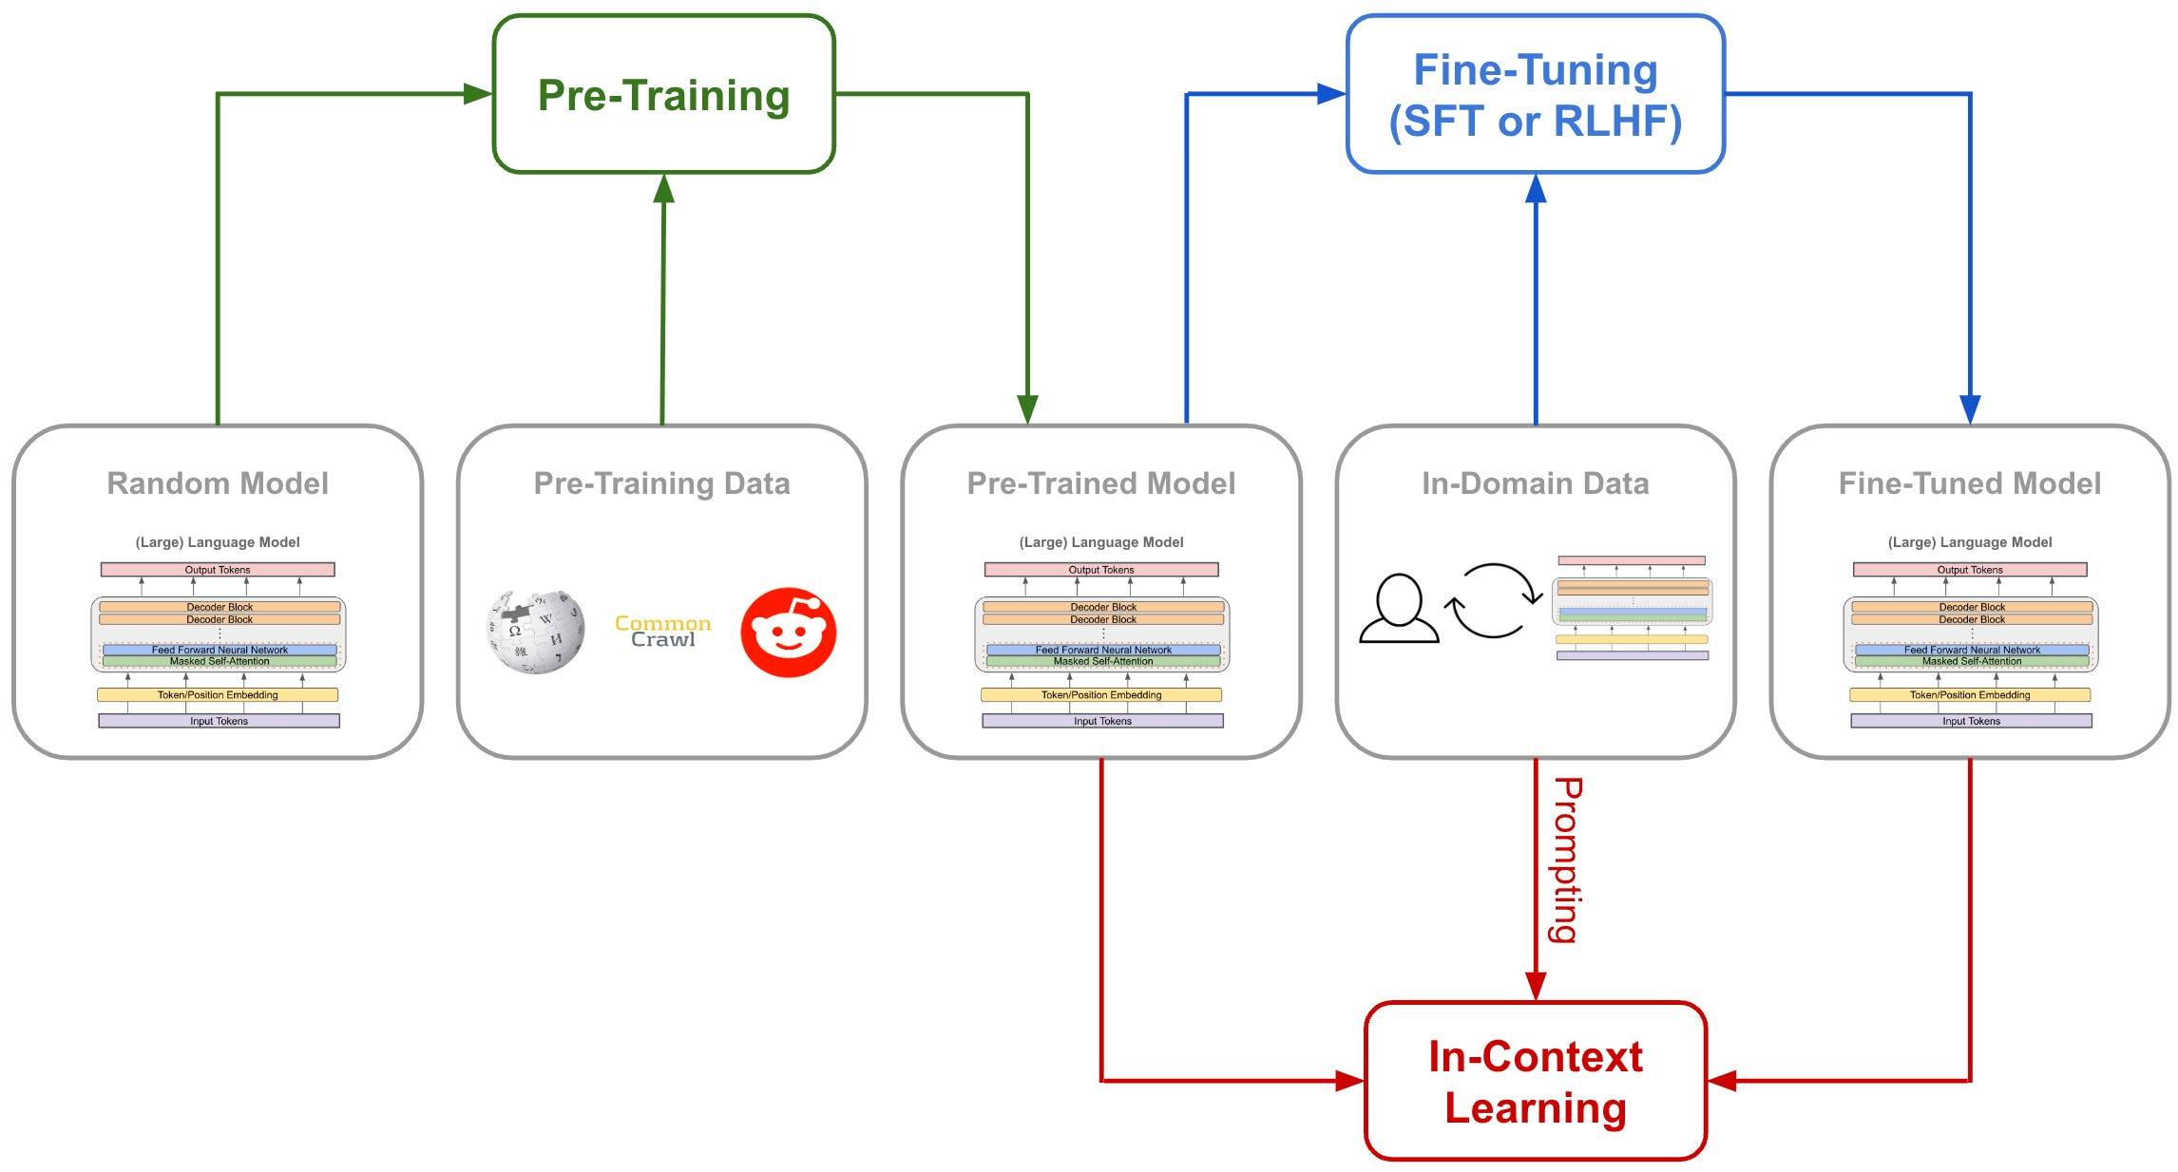
generic “instruct“ versions of LLMs (potentially also aligned)
e.g., Llama-2-7b-chat, Mistral-7B-Instruct
expert LLMs
base LLM: poor instruction following, no proper multi-turn converstations
(e.g., Llama-2-7b, Mistral-7B)
ready to become an LLM chatbot
RAG

Slide 59
Use Cases of Instruction Tuning
task specialization (e.g., code generation)
domain-specific instructions (e.g., interpret molecular formulas)
style or tone adaptation (e.g., corporate writing style, friendly chatbot tone)
reasoning (CoT inputs) → reasoning models

Slide 60
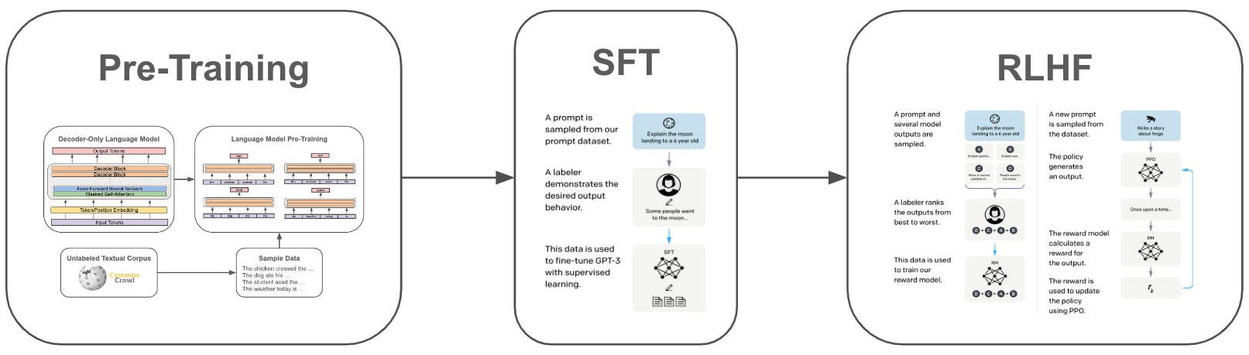
Preference Alignment
RLHF can achieve both instruction following and preference alignment
here: GPT-3
source
idea: aligning LLM output with human preferences
InstructGPT: SFT followed by reinforcement learning from human feedback (RLHF)

Slide 61
GPT-3 → InstructGPT → ChatGPT
dialog system (aka conversational agent or chatbot): any system designed to communicate with humans using natural language
with instruction-tuned and aligned LLMs: assistant-style models
crucial: multi-turn dialogue
→ passing conversation history as part of input to LLM at each step
lightweight PyTorch re-implementation of ChatGPT: nanochat

Slide 62
Prompt Engineering
prompt: user interface to the model
prompt engineering: shape model behavior using well-structured prompts
difference from traditional user interfaces:
probabilistic, not deterministic (shape the distribution of the model’s responses)
→ good prompts can improve a model‘s performance and reduce hallucination, bias, or inefficiency
prompt engineering, GPT guide

Slide 63
Typical Prompt Structure
prompt = instruction + context + query + examples + constraints + output cue
task definition: tells the model what to do
input/problem: content you want the model to work on
formatting/style/scope: specify limits (length, tone, format, …)
indicator: signal that tells the model where to start responding
optional background information: provides grounding or domain-specific details (external knowledge, role assignment, scenario setup)
few-shot component: show the model what good outputs look like

Slide 64
Example Prompt
Explain the following statement in three sentences.
Text: "Large language models show emergent abilities when scaled."
Answer:
instruction: Explain the following statement in three sentences.
query (input/problem): Large language models show emergent abilities when scaled.
constraint: implicit → in three sentences
output cue: Answer:

Slide 65
Simplest Possible Prompt
often query phrased as instruction:
Explain: Large language models show emergent abilities when scaled.
but without instruction, model just completes/continues the query text (usually not really useful):
Large language models show emergent abilities when scaled.
At the bare minimum, you only need the query. But for reliable, controllable outputs, you usually need to scaffold it with instruction, context, constraints, etc.

Slide 66
Best Practices: Clear Instruction & Query
Tell me about photosynthesis.
better:
Explain photosynthesis in simple terms suitable for a 12-year-old, using a short paragraph and one analogy.
→ clearly state what you want the model to do (best when specific, unambiguous, and outcome-focused)

Slide 67
Best Practices: Give Context
Write about the causes of the French Revolution.
better:
You are a historian writing a study guide for undergraduate students.
Write a concise explanation of the causes of the French Revolution, highlighting 3 major factors.
context: You are a historian writing a study guide for undergraduate students.
→ role assignment and audience specification steer tone and depth

Slide 68
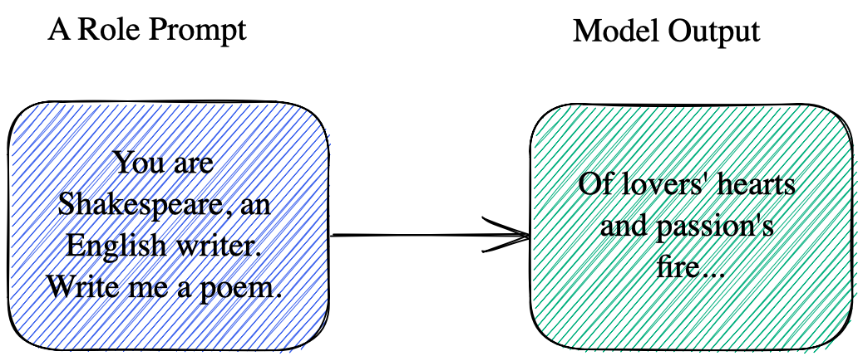
Aka Role Prompting

Slide 69
Best Practices: Specify Constraints
List some facts about Mars.
better (if you want specific outputs):
List exactly 3 scientifically verified facts about Mars.
Output them in JSON format with keys: "fact1", "fact2", "fact3".

Slide 70
Output Indicators
earlier models (pre-ChatGPT) were very sensitive to formatting (training datasets contained clear separators)
→ certain cues like Answer:, A:, Response:, or even ### dramatically affected performance (better alignment with training data)
not strictly required anymore for modern instruction-tuned LLMs
but can still be useful for automation or complex prompts (improve consistency, reduce ambiguity):
classification: Label:
code generation: Code:

Slide 71
Examples/Demonstrations
Convert these temperatures from Celsius to Fahrenheit:
25, 30, 35
few-shot examples help for unusual, complex, or under-specified tasks:
Convert these temperatures from Celsius to Fahrenheit:
C: 0 → F: 32
C: 10 → F: 50
C: 20 → F: 68
Now continue for:
C: 25, 30, 35

Slide 72
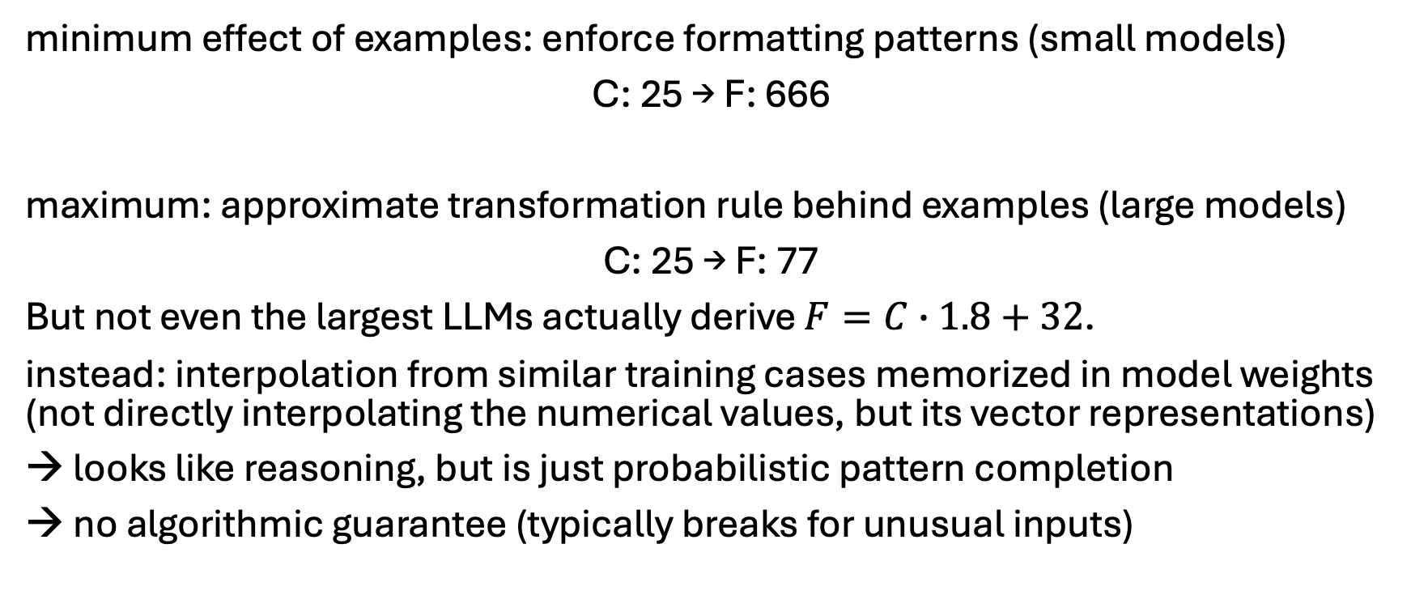
Important Subtlety: Formatting & Abstraction
minimum effect of examples: enforce formatting patterns (small models)
C: 25 → F: 666
maximum: approximate transformation rule behind examples (large models)
C: 25 → F: 77
But not even the largest LLMs actually derive $F=C∙1.8+32$.
instead: interpolation from similar training cases memorized in model weights (not directly interpolating the numerical values, but its vector representations)
→ looks like reasoning, but is just probabilistic pattern completion
→ no algorithmic guarantee (typically breaks for unusual inputs)
modern reasoning models: tool use to the rescue

Slide 73
Structured Design
So, prompts aren’t random — they have designable components.
different tasks emphasize different sections:
creative writing → role/context
(approximate) reasoning → examples
structured output → constraints

Slide 74
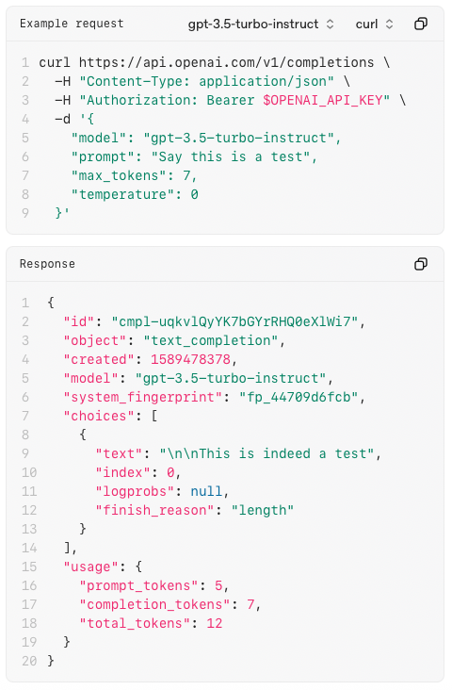
Interfaces to Chatbots
UI
web/mobile apps
messaging platforms (Teams, WhatsApp, …)
voice interfaces (Alexa, Siri, …)
API (typically REST / HTTP endpoints)
example: OpenAI’s /completions
send structured request (usually JSON) with prompt and receive structured response
enables integration into apps, websites, backend services

Slide 75
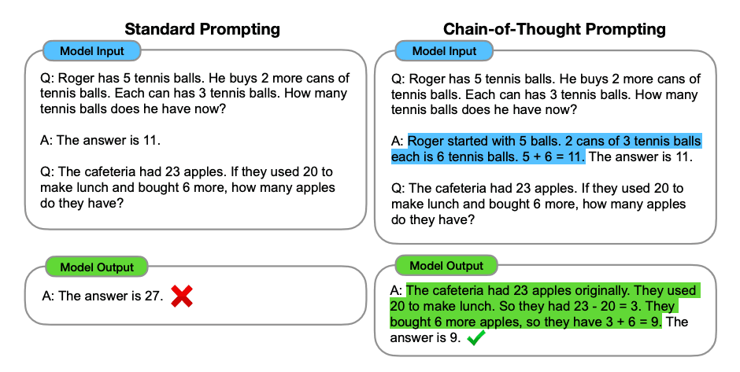
Chain-of-Thought Prompting (CoT)
explicitly ask the model to reason step by step before giving a final answer
originally, by providing at least one reasoning example:
makes model outputs more legible
but no genuine interpretability of underlying LLM reasoning processes

Slide 76
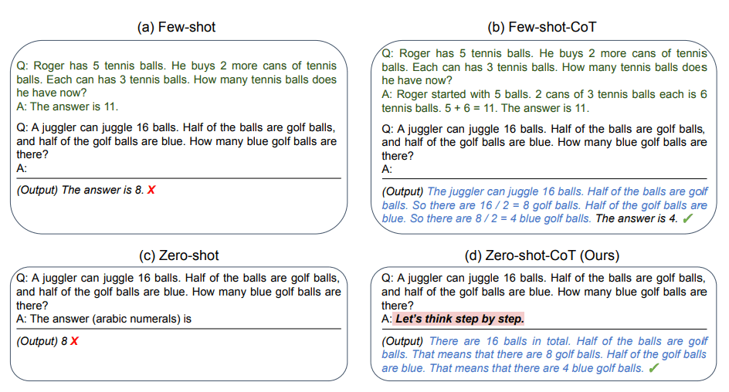
Zero-Shot CoT
also works without examples, just through clever instructions ...
source

Slide 77
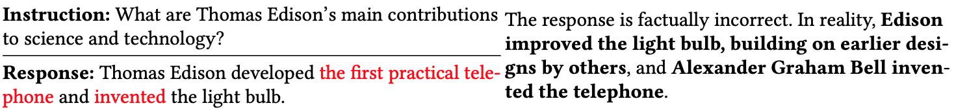
Hallucinations
knowledge encoded implicitly in weights rather than as explicit facts
→ probabilistic pattern completion can produce hallucinated facts
can be mitigated by retrieving the corresponding information from an external knowledge base and pasting it in context
(prompt engineering → context engineering)

Slide 78
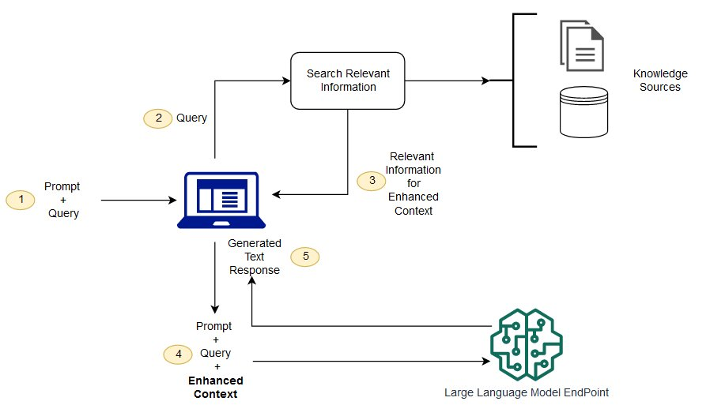
Retrieval Augmented Generation (RAG)
vector similarity
keyword
hybrid
private data (alternative to finetuning)
internet (browser as tool)
structured APIs
typically, data the model wasn‘t trained on

Slide 79
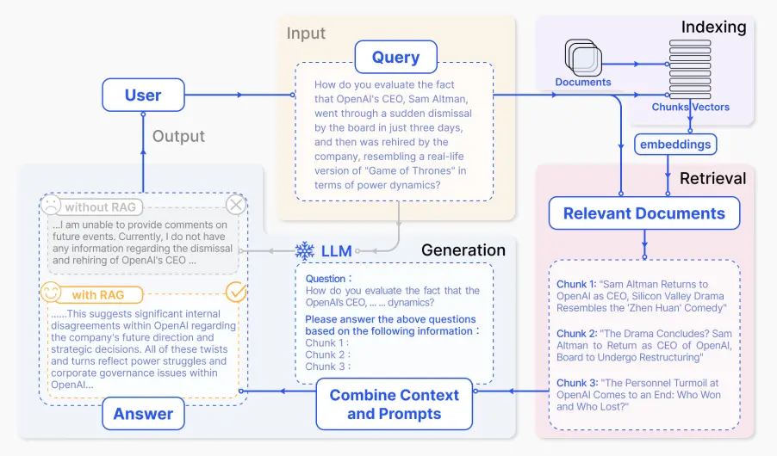
source

Slide 80
Embeddings & Vector Similarity Search
RAG approach:
embed your documents (or passages) into a vector space (typically vector databases like FAISS, Pinecone, Weaviate, etc.)
embed your query in the same space
use a vector similarity search (like cosine similarity or dot product) to retrieve the most relevant documents
feed those retrieved documents into your LLM to generate an answer
you generally don’t embed word-by-word → sentence embeddings
idea: average pooling over contextual token embeddings of transformer
better: models specifically finetuned for semantic similarity (e.g., SBERT)

Slide 81
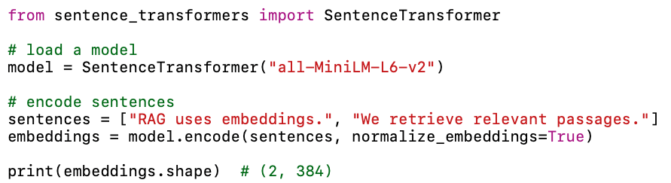
Example: sentence-transformers

Slide 82
Advanced Prompting Techniques
self-consistency: aggregation of multiple sampled CoT reasoning paths
meta-prompts / prompt templates: using one prompt to generate another
prompt chaining: e.g., 1: extract facts → 2: summarize → 3: critique
scaffolding: multi-turn prompt orchestration, planning, subtask decomposition
reflexion: model revisits its output, identifies errors or gaps, and revises
automatic prompt generation and optimization (e.g., OPRO)
role-playing and system prompts: e.g., teacher, critic, planner

Slide 83
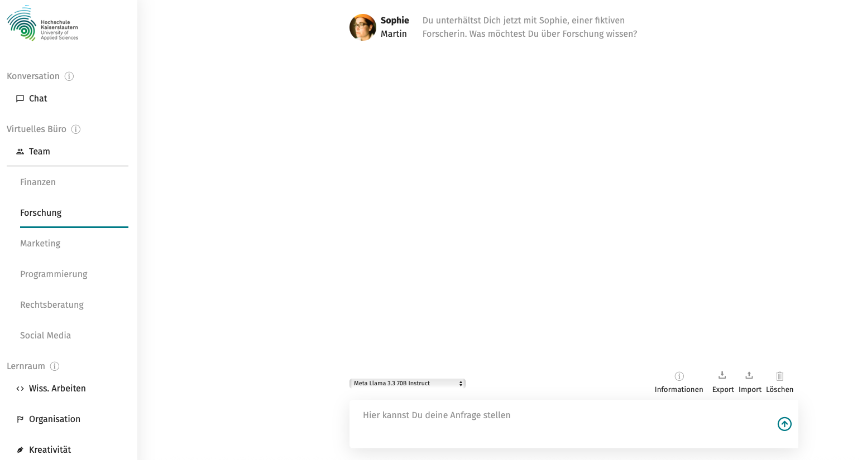
System Prompts
EDU-KI Chat:
interaction framed by a role assignment prompt
typically set in the system prompt layer (not visible to the user)
→ user prompt is then interpreted within that predefined persona

Slide 84
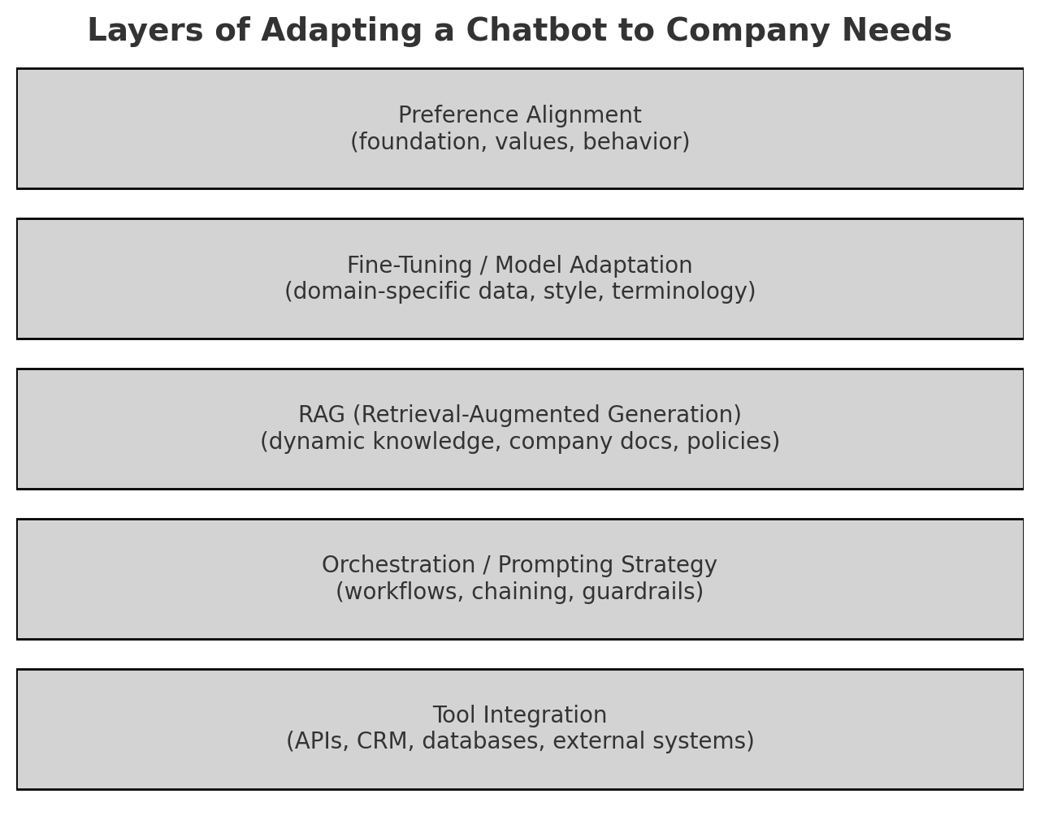

Slide 85
Rule of Thumb
use prompting → for small adjustments
use RAG → for up-to-date knowledge, large knowledge bases, or private data
use finetuning → for domain-specific expertise, custom style, or tasks that need the model’s behavior to change fundamentally

Slide 86

Agents
latest AI evolutionary step: LLMs as assistants to LLMs as agents
passive, reactive
responding to user prompts
active, autonomous, decision-making entities
acting on goals or tasks

Slide 87

Agentic Intelligence
goal: autonomous problem-solving
decomposition of complex task in simpler steps
(uses reasoning capabilities)

Slide 88

Example: LLM Use in Coding
autonomous systems like AutoGPT plan and execute tasks with minimal human oversight
interactive pair-programming with tools like GitHub Copilot or Cursor
using ChatGPT or similar for snippets and Q&A

Slide 89
Intuitive and Analytical Thinking
two systems of human thinking (from Kahneman, Thinking, Fast and Slow):
system 1: fast, automatic, intuitive, effortless, often subconscious
system 2: slow, deliberate, analytical, effortful, conscious
LLMs analogous to system 1 (although without true intuition or understanding), lacking the depth of reflective, analytic reasoning
→ for agentic intelligence, need to enhance LLMs with system 2 capabilities, including tool usage and fact-checking

Slide 90

Tool Usage
example: OpenAI
crucial LLM capabilities:
know how to access different tools
code interpreters
web search
calculators (to overcome lack of mathematical understanding)
…
select right tool at right time

Slide 91
Acquistion of Tool Usage Skills
using instruction-tuned LLMs (like ChatGPT) as agent:
core capability (how to use a tool) comes from pretraining and different finetuning stages
tool access controlled at runtime via prompting and system messages
tool selection (when to use which tool) decided from context
potentially, custom finetuning for specific tools or workflows

Slide 92
Test-Time Scaling
improve a model’s performance (especially reasoning capabilities) without retraining it, by allocating more compute during inference time:
more complex prompting strategies (CoT, self-consistency, prompt optimization, …)
extensive tool use
→ test-time compute (number of samples, reasoning steps) as another scaling law (in addition to parameters, training data, training compute)

Slide 93
Reasoning Models
some reasoning capabilities:
standard LLMs using prompting strategies such as CoT or ReAct
→ reasoning emerges implicitly from pretraining (performance can be brittle and highly prompt-dependent)
better reasoning capabilities:
reasoning-specific LLMs explicitly trained or finetuned on reasoning objectives (often with CoT-style supervision or multi-step reasoning datasets)
→ learn to reason by default, not just when prompted
examples: OpenAI o1, DeepSeek-R1 (open source)

Slide 94
LLM Orchestration and Agents
wrappers around LLM calls to make them more useful in real-world applications
LLM orchestration:
pipelines + prompt templates + access to tools & memory + context management
→ structured environment
e.g., LangChain, LlamaIndex
agent systems:
LLM orchestration + autonomy/planning loop
→ kind of autopilot on top of orchestration layer
e.g., AutoGPT, OpenAgents, BabyAGI

Slide 95
Multi-Agent Systems
idea:
complex, distributed, and dynamic problems can be solved more efficiently, flexibly, and robustly by using multiple specialized agents rather than a single one
→ extended agent system:
LLM orchestration + autonomy/planning loop
+ coordination between multiple agents
e.g., AutoGen

Slide 96

Example for Combination of A2A and MCP
tool interoperability (MCP):
giving each agent a standardized interface to interact with the world (tools, data, APIs)
agent interoperability (A2A):
giving agents a standardized interface to interact with each other

Slide 97




hallucinations
LLM: kind of a lossy simulation of a savant with cognitive issues
encyclopedic knowledge
implicit knowledge & probabilistic pattern completion
only short-term memory in context
anterograde amnesia
interpolations from vector representations
huge models & massive pretraining: compression of the internet
jagged intelligence
from Karpathy

Slide 98
source

Slide 99
source

Slide 100

LLMs $≠$ AGI
current AI good at learning statistical patterns and making predictions
but no real “understanding” or world model
And don’t get fooled by alignment ;).

